Slide 1
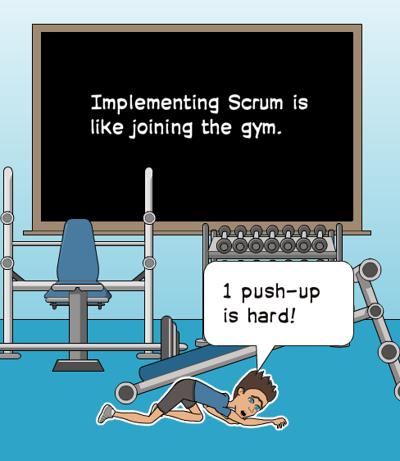
Scrum
From the Trenches
@DonovanBrown

Slide 2
General Principles
Product is built incrementally
Frequent inspection and adaption (course correction)
Transparency (Product and Sprint backlogs are public)
Product Owner, Development Team, Scrum Master
Scrum Teams are self-organizing and cross-functional

Slide 3

Product Owner
There can be only one
Do not lead by committee
@DonovanBrown

Slide 4

Selecting an Iteration Length
Never change mid-iteration
Do not change to fit in more work for an iteration
Err on shorter versus longer
Never go over four (4) weeks
@DonovanBrown
Notes:
http://donovanbrown.com/post/The-Rules-Apply-to-Everyone

Slide 5

Never skip the rituals
Educate everyone on the purpose of the meetings
Never go over the time box
Running these meetings is a skill you must develop
@DonovanBrown

Slide 6
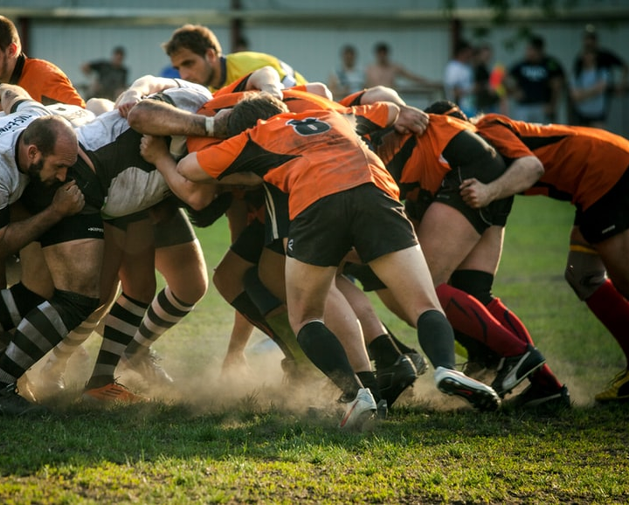
Daily Scrum (aka Standup)
Running a stand up is a skill
Never solve issues during your stand up
It must be completed in 15 minutes or less
Identify impediments
@DonovanBrown
Notes:
http://donovanbrown.com/post/Pass-What-Does-Pass-Mean

Slide 7
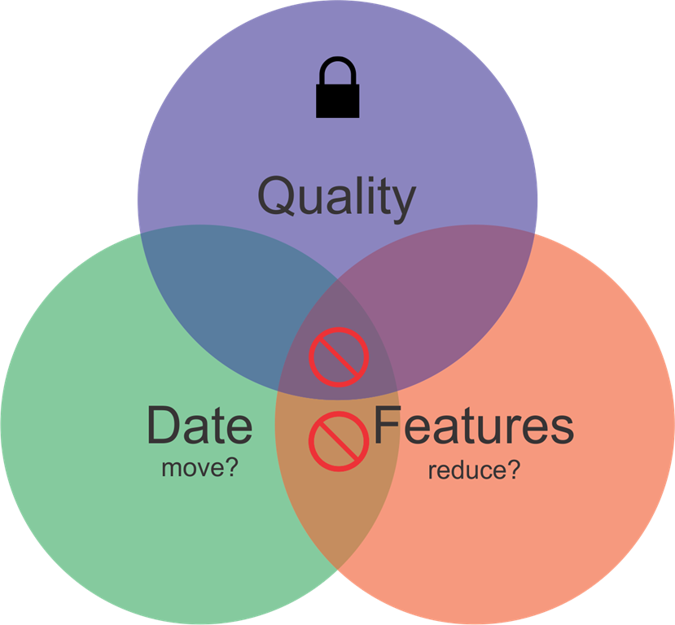
Estimates are not guarantees
@DonovanBrown
Notes:
http://donovanbrown.com/post/Stop-Getting-Stuff-Done-After-You-Said-You-Couldnt

Slide 8

Estimates
Never accept an estimate over 4 hours
  Are more accurate
  Enables parallel development
  Confirms alignment with DoD
Never start from a date
@DonovanBrown
Notes:
Photo by Maddi Bazzocco on Unsplash

Slide 9
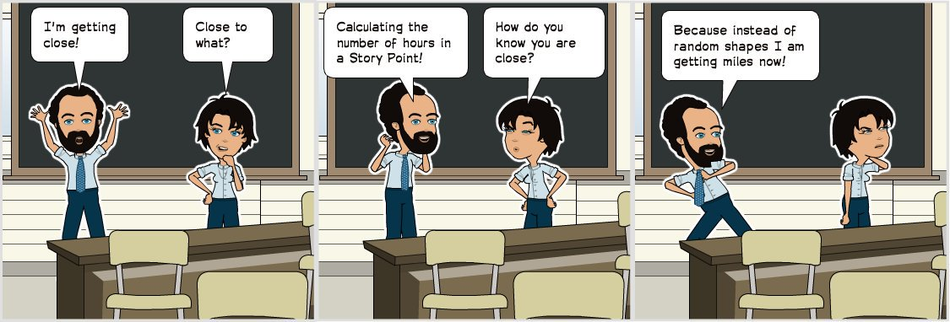
Story Points do not equal hours

Slide 10
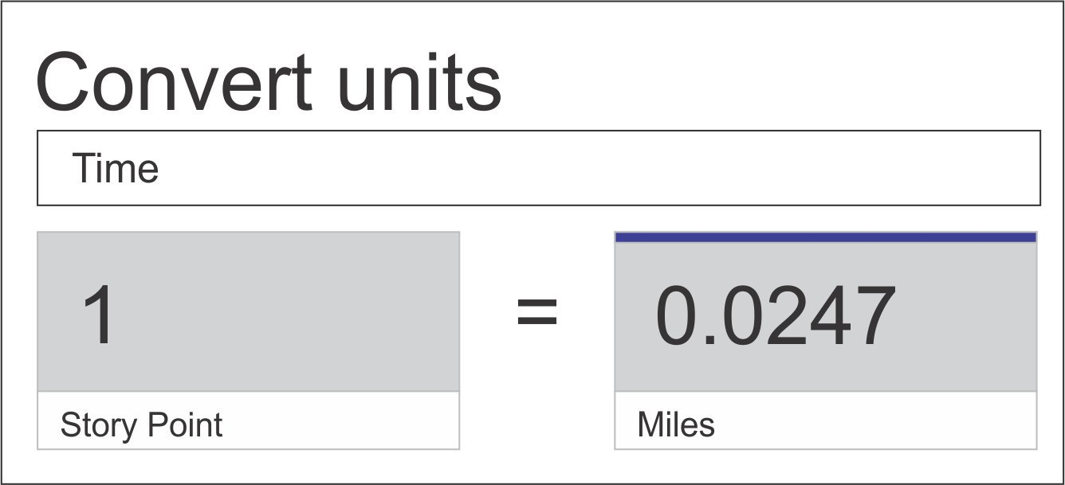
Story Points do not equal hours
Notes:
An hour for team A equals an hour for team B.
But a story point for team A has not comparison to a story point for team B.

Slide 11
Definition of Done (DoD)
Must be clear
Visible to everyone
Mature it over time
Notes:
D

Slide 12
Azure DevOps Team’s DoD
Live in production, collecting telemetry that examines the hypothesis which motivated the deployment.

Slide 13
Groom your Backlog
Allocate time in each iteration to groom what is coming next (20%)
Have all disciplines represented in grooming (Dev, QA, InfoSec, etc.)
Set correct priorities

Slide 14
Merge Often
No long lived branches
Helps avoid merge bombs
Implement feature flags

Slide 15
The Rules Apply to Everyone
No one is above the law
Even the CEO must obey the rules
Notes:
http://donovanbrown.com/post/The-Rules-Apply-to-Everyone

Slide 16
Reviews
Even if you have nothing to show
Never cancel this meeting
Notes:
http://donovanbrown.com/post/Stop-Getting-Stuff-Done-After-You-Said-You-Couldnt

Slide 17
Retrospective
The good, bad and the ugly
Define action for bad and ugly items
Refine your process
Review your DoD

Slide 18



Resources

Slide 19
Resources
Scrum.org
DonovanBrown.com

