Slide 1


Digital Transformation
Donovan Brown, Principal Cloud Advocate
@DonovanBrown

Slide 2
The world runs on code
1 0 1 0 0 0 1 1 1 0 0 1 0 1 0 0 0 1 1 1 0 0 1 0 1 0 1 0 0 0 1 0 1 0 1 0 0 0 1 0 1 1 1 0 1 0 1 0 1 1 1 0 1 0 1 0 1 1 1 0 1 0 1 0 0 0 1 1 1 0 0 1 0 1 0 0 0 1 1 1 0 0 1 0 1 0 1 0 0 0 1 0 1 0 1 0 0 0 1 0 1 1 1 0 1 0 1 0 1 1 1 0 1 0 1 0 1 1 1 0 1 0 1 0 0 0 1 1 1 0 0 1 0 1 0 0 0 1 1 1 0 0 1 0 1 0 1 0 0 0 1 0 1 0 1 0 0 0 1 0 1 1 1 0 1 0 1 0 1 1 1 0 1 0 1 0 1 1 1 0 1 0 1 0 0 0 1 1 1 0 0 1 0 1 0 0 0 1 1 1 0 0 1 0 1 0 1 0 0 0 1 0 1 0 1 0 0 0 1 0 1 1 1 0 1 0 1 0 1 1 1 0 1 0 1 0 1 1 1 0 1 0 1 0 0 0 1 1 1 0 0 1 0 1 0 0 0 1 1 1 0 0 1 0 1 0 1 0 0 0 1 0 1 0 1 0 0 0 1 0 1 1 1 0 1 0 1 0 1 1 1 0 1 0 1 0 1 1 1 0 1 0 1 0 0 0 1 1 1 0 0 1 0 1 0 0 0 1 1 1 0 0 1 0 1 0 1 0 0 0 1 0 1 0 1 0 0 0 1 0 1 1 1 0 1 0 1 0 1 1 1 0 1 0 1 0 1 1 1 0 1 0 1 0 0 0 1 1 1 0 0 1 0 1 0 0 0 1 1 1 0 0 1 0 1 0 1 0 0 0 1 0 1 0 1 0 0 0 1 0 1 1 1 0 1 0 1 0 1 1 1 0 1 0 1 0 1 1 1 0 1 0 1 0 0 0 1 1 1 0 0 1 0 1 0 0 0 1 1 1 0 0 1 0 1 0 1 0 0 0 1 0 1 0 1 0 0 0 1 0 1 1 1 0 1 0 1 0 1 1 1 0 1 0 1 0 1 1 1 0 1 0 1 0 0 0 1 1 1 0 0 1 0 1 0 0 0 1 1 1 0 0 1 0 1 0 1 0 0 0 1 0 1 0 1 0 0 0 1 0 1 1 1 0 1 0 1 0 1 1 1 0 1 0 1 0 1 1 1 0 1 0 1 0 0 0 1 1 1 0 0 1 0 1 0 0 0 1 1 1 0 0 1 0 1 0 1 0 0 0 1 0 1 0 1 0 0 0 1 0 1 1 1 0 1 0 1 0 1 1 1 0 1 0 1 0 1 1 1 0 1 0 1 0 0 0 1 1 1 0 0 1 0 1 0 0 0 1 1 1 0 0 1 0 1 0 1 0 0 0 1 0 1 0 1 0 0 0 1 0 1 1 1 0 1 0 1 0 1 1 1 0 1 0 1 0 1 1 1 0 1 0 1 0 0 0 1 1 1 0 0 1 0 1 0 0 0 1 1 1 0 0 1 0 1 0 1 0 0 0 1 0 1 0 1 0 0 0 1 0 1 1 1 0 1 0 0 0 1 1 1 0 0 1 0 1 0 0 0 1 1 1 0 0 1 0 1 0 1 0 0 0 1 0 1 0 1 0 0 0 1 0 1 1 1 0 1 0 1 0 1 1 1 0 1 0 1 0 1 1 1 0 1 0 1 0 0 0 1 1 1 0 0 1 0 1 0 0 0 1 1 1 0 0 1 0 1 0 1 0 0 0 1 0 1 0 1 0 0 0 1 0 1 1 1 0 1 0 1 0 1 1 1 0 1 0 1 0 1 1 1 0 1 0 1 0 0 0 1 1 1 0 0 1 0 1 0 0 0 1 1 1 0 0 1 0 1 0 1 0 0 0 1 0 1 0 1 0 0 0 1 0 1 1 1 0 1 0 1 0 1 1 1 0 1 0 1 0 1 1 1 0 1 0 1 0 0 0 1 1 1 0 0 1 0 1 0 0 0 1 1 1 0 0 1 0 1 0 1 0 0 0 1 0 1 0 1 0 0 0 1 0 1 1 1 0 1 0 1 0 1 1 1 0 1 0 1 0 1 1 1 0 1 0 1 0 0 0 1 1 1 0 0 1 0 1 0 0 0 1 1 1 0 0 1 0 1 0 1 0 0 0 1 0 1 0 1 0 0 0 1 0 1 1 1 0 1 0 1 0 1 1 1 0 1 0 1 0 1 1 1 0 1 0 1 0 0 0 1 1 1 0 0 1 0 1 0 0 0 1 1 1 0 0 1 0 1 0 1 0 0 0 1 0 1 0 1 0 0 0 1 0 1 1 1 0 1 0 1 0 1 1 1 0 1 0 1 0 1 1 1 0 1 0 1 0 0 0 1 1 1 0 0 1 0 1 0 0 0 1 1 1 0 0 1 0 1 0 1 0 0 0 1 0 1 0 1 0 0 0 1 0 1 1 1 0 1 0 1 0 1 1 1 0 1 0 1 0 1 1 1 0 1 0 1 0 0 0 1 1 1 0 0 1 0 1 0 0 0 1 1 1 0 0 1 0 1 0 1 0 0 0 1 0 1 0 1 0 0 0 1 0 1 1 1 0 1 0 1 0 1 1 1 0 1 0 1 0 1 1 1 0 1 0 1 0 0 0 1 1 1 0 0 1 0 1 0 0 0 1 1 1 0 0 1 0 1 0 1 0 0 0 1 0 1 0 1 0 0 0 1 0 1 1 1 0 1 0 1 0 1 1 1 0 1 0 1 0 1 1 1 0 1 0 1 0 0 0 1 1 1 0 0 1 0 1 0 0 0 1 1 1 0 0 1 0 1 0 1 0 0 0 1 0 1 0 1 0 0 0 1 0 1 1 1 0 1 0 1 0 1 1 1 0 1 0 1 0 1 1 1 0 1 0 1 0 0 0 1 1 1 0 0 1 0 1 0 0 0 1 1 1 0 0 1 0 1 0 1 0 0 0 1 0 1 0 1 0 0 0 1 0 1 1 1 0 1 0 1 0 1 1 1 0 1 0 1 0 1 1 1 0 1 0 1 0 0 0 1 1 1 0 0 1 0 1 0 0 0 1 1 1 0 0 1 0 1 0 1 0 0 0 1 0 1 0 1 0 0 0 1 0 1 1 1 0
1 0

Slide 3

The world runs on code
Mobile device OS
12 million lines of code
Boeing 787
14 million lines of code
Car
120 million lines of code
Source: https://informationisbeautiful.net/visualizations/million-lines-of-code/

Slide 4
  91%
Every company wants
to digitally transform
of business leaders see Digital Transformation as a way of sparking innovation and finding efficiencies¹
A journey with one destination
but different paths to get there
  85%
say they must offer digital services
or become irrelevant²
¹ ISACA: Information Systems Audit and Control Association, 2018
² Couchbase: Couchbase Survey, August 2018

Slide 5



A transformation strategy drives innovation and growth
Organizations that harness data, the cloud, and AI outperform their peers²
~
2X
Operating margin
$100M
Additional
operating income
Infrastructure
80% reduction in administrative work
Apps
Websites running in minutes
Data
New data analysis approaches
Remove patching, network
setup, firewall configuration
Enable application innovation
—Forrester TEI of Azure¹
Remove the need to wait for servers²
Improve app delivery time by 50%¹
—Forrester TEI of Azure¹
With cloud, we collect data we couldn’t before
Make personal connections that standout in sea of information
—Anheuser-Busch InBev
¹The Total Economic Impact™ Of Microsoft Azure Platform-As-A Service, Forrester Consulting, June 2016
²Source: Keystone Strategy interviews October 2015—March 2016

Slide 6


Digital transformation is an economic imperative
@DonovanBrown

Slide 7


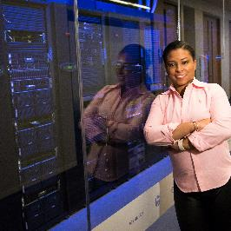

Vision for Digital Transformation
Engage Your Customers
Deliver personalized, rich, connected experiences in journeys your customers choose.
Empower Your Employees
Keep up with your fast-moving customers, efficiently collaborating to anticipate and meet customer demands.
Optimize Your Operations
Increase the flow of information across your entire business, better manage your resources, and keep your business processes synchronized across all boundaries.
Transform Your Products
Expand your reach using digital channels, anticipate customer needs, understand how your products are used, and quickly develop and improve products and services.

Slide 8

Cloud computing
@DonovanBrown

Slide 9
Benefits of Cloud computing
High availability
Scalability
Elasticity
Agility
Geo-distribution
Disaster recovery
Faster innovation
Flexible resources
Economies of scale

Slide 10
OpEx vs CapEx
No up-front cost
Pay for what you use
Instant deduction
Up-front cost
Physical infrastructure
Depreciation

Slide 11
Cloud types
Public
Internet
Owned & operated by 3rd party
Private
Private network
Owned by your organization
Hybrid
Combines public and private clouds

Slide 12



Cloud service models
IaaS
(Buy a car)
PaaS
(Rent a car)
SaaS
(Call an Uber)
Virtual machines
Websites
Web Jobs
Cloud Services
SQL Databases
Azure DevOps
Dynamics 365
Office 365

Slide 13
Responsibilities
On-Premises
Application
IaaS
Application
PaaS
Application
Data
Runtime
Middleware
OS
Virtualization
Servers
Storage
Networking
Data
Runtime
Middleware
OS
Virtualization
Servers
Storage
Networking
Data
Runtime
Middleware
OS
Virtualization
Servers
Storage
Networking

Slide 14

Journey to the cloud
On-premises
Infrastructure Platform
IaaS
Infrastructure Platform
“Lift and shift”
PaaS
Managed Infrastructure
Serverless
Managed Container Platform
Low/no code
Application Platform
Migrate
Innovate

Slide 15
What is DevOps?
People. Process. Products.
Build& Test
Deploy
DevOps is the union of people, process, and products to enable continuous delivery of value to your end users.
“
Continuous
Delivery
Develop
Operate
”
Plan
&
Track
Monitor
&
Learn

Slide 16
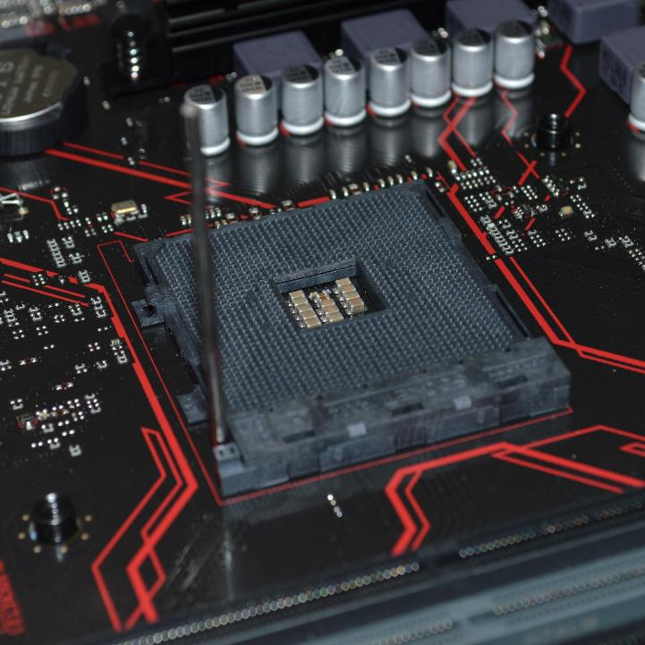
What is IaC?
Infrastructure as Code (IaC) is the management of infrastructure (networks, virtual machines, load balancers, and connection topology) in a descriptive model, using version control to store the files.
@DonovanBrown

Slide 17
Why is IaC important?
Review changes
No more snowflakes
Configuration drift
Reduce human error
Security

Slide 18
Additional Benefits
Save time and money
Temporary environments
Disaster recovery
Testing and validation
Speed up procurement
Stops “Shadow IT”

Slide 19

Putting it all together
@DonovanBrown

Slide 20








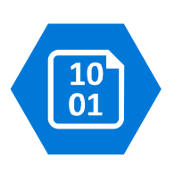



Modern application pattern
Highly available multi-region web application
Active region
App Service Plan
Queue
Function App
Redis cache
SQL Database
Cosmos DB
Azure Active Directory
Azure CDN
Blob
Static content
Azure Search
Geo-replication
Authentication
Standby region
Internet
Azure
Front Door
App Service Plan
Queue
Function App
Redis cache
SQL Database
Cosmos DB
DNS lookup
Azure DNS
Azure Search
Notes:
A multi-region architecture can provide higher availability than deploying to a single region. If a regional outage affects the primary region, you can use Front Door to fail over to the secondary region. This architecture can also help if an individual subsystem of the application fails.
https://docs.microsoft.com/en-us/azure/architecture/reference-architectures/app-service-web-app/multi-region

Slide 21




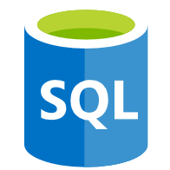


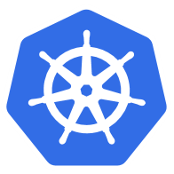





Modern application pattern
Kubernetes
Azure Kubernetes Service (AKS)
Front end
Client Apps
Azure Load Balancer
Ingress
External
data stores
CI/CD
Microservices
Helm
upgrade
Azure Pipelines
Docker push
Container registry
Docker pull
Kubernetes
Virtual Network
RBAC
Dev/Ops
Azure Active Directory
Monitor
Azure Key Vault
Notes:
This reference architecture shows a microservices application deployed to Azure Kubernetes Service (AKS). It describes a basic AKS configuration that can be the starting point for most deployments.
A microservice is a loosely coupled, independently deployable unit of code. Microservices typically communicate through well-defined APIs and are discoverable through some form of service discovery. The service should always be reachable even when the pods move around. The Kubernetes Service object is a natural way to model microservices in Kubernetes.
https://docs.microsoft.com/en-us/azure/architecture/reference-architectures/containers/aks-microservices/aks-microservices

Slide 22
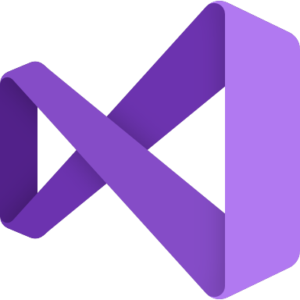




Cloud Native Apps
Containerized application development
Scale
Dev Spaces
Test
AKS dev cluster
GitHub repos
Container image
Azure Container Registry
AKS production cluster
Azure Monitor
Debug
Inner loop
GitHub Actions
Helm chart
Terraform

Slide 23

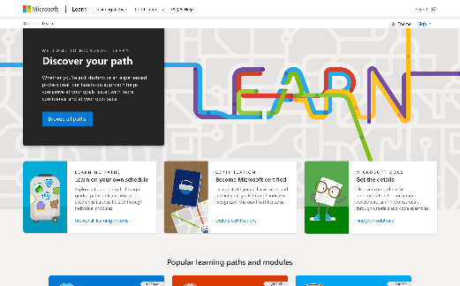
Empower employees with Microsoft Learn
Microsoft.com/Learn
Learn what technology does or prepare for role-based certification
Free step-by-step, bite-sized tutorials and engaging modules
Learning paths with interactive labs, sample code, and free test drive products
From beginners to advanced learners
Azure Fundamentals - http://bit.ly/AzFun

Slide 24
Thank you!
Notes:
Thank you!

