Slide 1
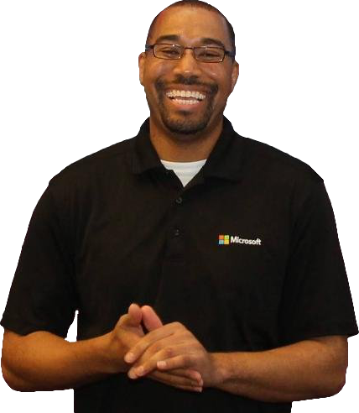
Zero to DevOps
Donovan Brown
@DonovanBrown

Slide 2
Who am I?
Donovan Brown | @DonovanBrown
  Senior DevOps Program Manager
  Blog at DonovanBrown.com
  Technical YouTube Channel
    tinyurl.com/DonovanBrown
Fun Stuff
  Professional Air Hockey player
    Highest ranking 11th in the world
  Competitive driver
  Developer for over 20 years

Slide 3
Session objectives and takeaways
Session objectives:
  Define DevOps
  Demo DevOps offering
Session takeaways:
  Microsoft provides a full DevOps solution
  Microsoft supports any language targeting any platform
Notes:
This slide is required. Do NOT delete. This should be the first slide after your Title Slide. This is an important year and we need to arm our attendees with the information they can use to Grow Share! Please ensure that your objectives are SMART (defined below) and that they will enable them to go in and win against the competition to grow share. If you have questions, please contact your Track PM for guidance. We have also posted guidance on writing good objectives, out on the Speaker Portal (https://www.mytechready.com).
This slide should introduce the session by identifying how this information helps the attendee, partners and customers be more successful. Why is this content important?
This slide should call out what’s important about the session (sort of the why should we care, why is this important and how will it help our customers/partners be successful) as well as the key takeaways/objectives associated with the session. Call out what attendees will be able to execute on using the information gained in this session. What will they be able to walk away from this session and execute on with their customers.
Good Objectives should be SMART (specific, measurable, achievable, realistic, time-bound). Focus on the key takeaways and why this information is important to the attendee, our partners and our customers.
Each session has objectives defined and published on www.mytechready.com, please work with your Track PM to call these out here in the slide deck.
If you have questions, please contact your Track PM. See slide 5 in this template for a complete list of Tracks and TPMs.

Slide 4
Agenda
What is DevOps
E2E Demo
Resources
Notes:
This slide is required. Do NOT delete. This should be the first slide after your Title Slide. This is an important year and we need to arm our attendees with the information they can use to Grow Share! Please ensure that your objectives are SMART (defined below) and that they will enable them to go in and win against the competition to grow share. If you have questions, please contact your Track PM for guidance. We have also posted guidance on writing good objectives, out on the Speaker Portal (https://www.mytechready.com).
This slide should introduce the session by identifying how this information helps the attendee, partners and customers be more successful. Why is this content important?
This slide should call out what’s important about the session (sort of the why should we care, why is this important and how will it help our customers/partners be successful) as well as the key takeaways/objectives associated with the session. Call out what attendees will be able to execute on using the information gained in this session. What will they be able to walk away from this session and execute on with their customers.
Good Objectives should be SMART (specific, measurable, achievable, realistic, time-bound). Focus on the key takeaways and why this information is important to the attendee, our partners and our customers.
Each session has objectives defined and published on www.mytechready.com, please work with your Track PM to call these out here in the slide deck.
If you have questions, please contact your Track PM. See slide 5 in this template for a complete list of Tracks and TPMs.

Slide 5

“DevOps is the union of people, process, and products to enable continuous delivery of value to our end users.”
- Donovan Brown
http://bit.ly/WhatIs-DevOps

Slide 6
Why is DevOps important
Your competition is already doing this
Increase velocity
Reduce downtime
Reduce human error

Slide 7
Any Language, Any Platform
Program in any language
  .NET
  Java
  Python
  Ruby
  Nodejs
  …
Develop on any OS
  Linux
  Mac
  Windows
Deploy to any Platform
  Android
  iOS
  Windows Phone
  Docker
  Azure
  AWS
  Linux
  Mac
  …

Slide 8
Manage the full stack
Telemetry
Application Insights
Monitor/Learn
Diagnostics
Application Insights
Performance
Application Insights
Collect Approvals
Release Management
Approve
Notify Approvers
Release Management
Manual Tests
Microsoft Test Manager
Test
Automated Tests
Coded UI, Web, Load
Create Test Data
BacPac with SSDT
Configure Application
Tokenization
App
Install Application
NuGet, WebDeploy, etc
Configure Environment
Desired State Configuration
Infra
Provision Environment
Azure Resource Manager
Tracking Work
TFS / VSTS
Plan
Planning Work
TFS / VSTS

Slide 9
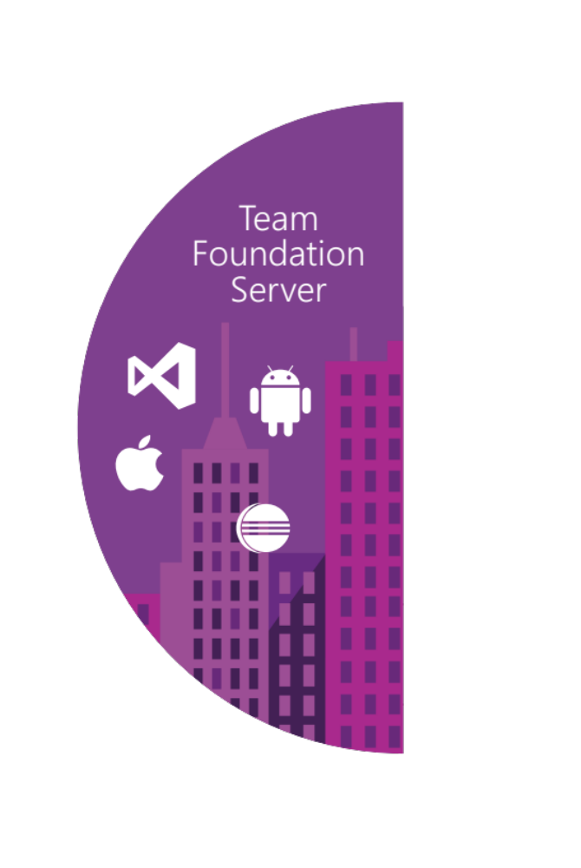






Our solution
Source control
Team Foundation
Server
Visual Studio
Team Services
Agile planning
Test case management
Build automation
Continuous deployment
Release management
Load testing
Lab management

Slide 10
Our solution
Source control
Team Foundation
Server
Visual Studio
Team Services
Agile planning
Test case management
Build automation
Continuous deployment
Release management
Load testing
Feedback management
Team collaboration
Application telemetry
Lab management

Slide 11








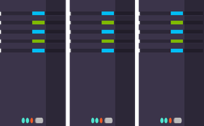
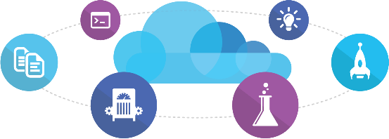
Microsoft
Ecosystem
People | Process | Products
01
02
03
Developer Workstation
Build/CI
04
Release
Develop
Monitor
Build & Test
TFS / VSTS
Deploy
Release Management
for Visual Studio
Release Management
for Visual Studio
Team Collaboration
Monitor & Learn
Test
Automation Service
VSTS
TFS / VSTS
PowerShell | WAML
Application Insights
TFS / VSTS
Azure Resource Management
Microsoft Test Manager
xPlat Command Line
TFS
DEV
TEST
QA
Workstations - On-Premises | Hybrid | Cloud
ALM Services - On-Premises | Hybrid | Cloud
Environments - On-Premises | Hybrid | Cloud
Monitoring - On-Premises | Hybrid | Cloud

Slide 12
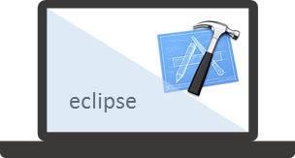













Mixed
Ecosystem
People | Process | Products
01
02
03
Developer Workstation
Build/CI
04
Configuration
Develop
Monitor
Build & Test
Deploy
Team Collaboration
Release
Monitor & Learn
Test
This graphic shows OSS and partner products that are integrated with the Microsoft DevOps solution

Slide 13
Demo
Notes:
Create Project
Create Readme to create Repo
Create Build
Create Release
Create Azure Connection
Create User Story
Create Task
Create Branch
Associate work items
Clone Repo
Add project
Build fails
Show build
Fix build associate bug
Code get deployed
Tour Build and RM
Clone
Show Build from VS
Pin summaries to dashboard
West US
E2EDemo
MyE2EHelloWorldDemo

Slide 14
In review: session objectives and takeaways
Session objectives:
  Define DevOps
  Demo DevOps offering
Session takeaways:
  Microsoft provides a full DevOps solution
  Microsoft supports any language targeting any platform
Notes:
This slide is recommended as a final slide to recap the objectives of the session to remind attendees what you said would be covered and to highlight that you did indeed cover those points. The objectives listed on this slide should match the objectives covered on the required Objective slide at the beginning of your presentation.
If you have questions, please contact your Track PM. See slide 5 in this template for a complete list of Tracks and TPMs.

