Slide 1

The Ops side of DevOps
@DonovanBrown
DevOps Manager
Microsoft
Notes:
The importance of Infrastructure as Code (IaC)
https://www.cio.com/article/3017722/infrastructure/what-is-infrastructure-as-code-and-why-should-you-embrace-it.html
https://www.thoughtworks.com/insights/blog/infrastructure-code-reason-smile
https://docs.microsoft.com/en-us/azure/devops/learn/what-is-infrastructure-as-code

Slide 2
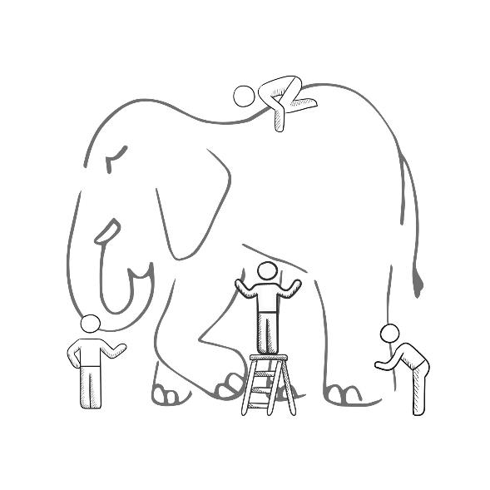
WHAT IS DEVOPS?
It’s a job title
It’s automation
It’s Development and
Operations collaboration
It means faster and smaller releases
Notes:
It was – and still is - the time of Agile and DevOps.
We had to formulate a DevOps strategy for our entire organization.
But what is DevOps? It can mean radically different things for different people!

Slide 3

“DevOps is the union of people, process, and products to enable continuous delivery of value to our end users.”
- Donovan Brown
http://bit.ly/WhatIs-DevOps

Slide 4
What is IaC
Infrastructure as Code (IaC) is the management of infrastructure (networks, virtual machines, load balancers, and connection topology) in a descriptive model, using version control to store the files.
Notes:
Or said another way. IaC is taking the environment upon which you intent to run your application and codifying it. The code is stored in version control and acted on using a CI/CD pipeline. No manual steps are taking in the portal to provision an environment.

Slide 5
Why is IaC important
Review changes
No more snowflakes
Configuration Drift
Reduce human error
Security

Slide 6
Additional Benefits
Save time and money
Temporary environments
Disaster Recovery
Testing and validation
Speed up procurement
Stops “Shadow IT”

Slide 7
Requirements
Files in source
CI/CD in place (automation)
Idempotency
Collaboration

Slide 8
Tooling
Azure Resource Manager Templates (ARM)
Azure CLI
Terraform
Chef
Puppet
Ansible

Slide 9
Best Practices
Do the same thing in each environment including production.
Parametrize your files. Dev, QA and Prod are parameter changes not new scripts.

Slide 10
Caution
Do not be afraid of production
Do not confuse with infrastructure automation
Notes:
I meet many teams moving towards IaC and high levels of automation. However, they still manually deploy to production.
Do not confuse with infrastructure automation. If you were to run the same scripts on the same server you might get errors.

Slide 11
Who are we?
League of Extraordinary Cloud DevOps Advocates
Cloud Developer Advocates
#LoECDA

Slide 12
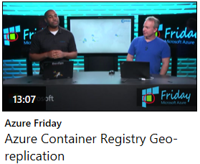
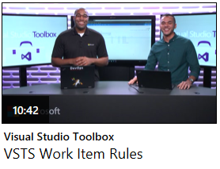
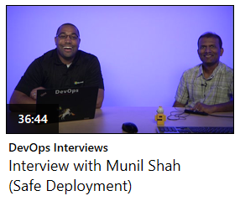
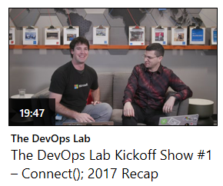

Resources
Channel 9
  Azure Friday
  Visual Studio Toolbox
  DevOps Interviews
  The DevOps Lab
Twitter
  @DonovanBrown
  #LoECDA
Web
  DonovanBrown.com

