Slide 1

Azure DevOps
Donovan Brown
Notes:
Welcome to the launch of Azure DevOps
Mr. DevOps
The man in the black shirt
Goal of this slide’s talking points:
Jamie/Donovan Intros
Teaser for what the next 90 minutes will be about
Convey general energy enthusiasm & start to get folks interested in sticking around.
Jamie Cool… Director of Program Management for Azure DevOps. Something we’re going to spend most of the next 90 minutes learning about.
Donovan intro…
Today we’re here to talk about some exciting announcements… the launch of a new set of DevOps services for Azure &

Slide 2
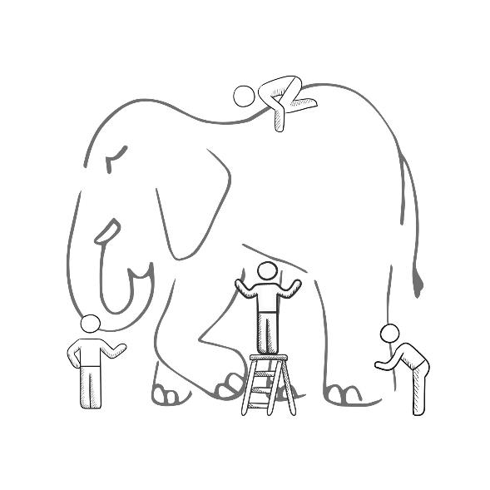
WHAT IS DEVOPS?
It’s a job title
It’s automation
It’s Development and
Operations collaboration
It means faster and smaller releases
@DonovanBrown
Notes:
It was – and still is - the time of Agile and DevOps.
We had to formulate a DevOps strategy for our entire organization.
But what is DevOps? It can mean radically different things for different people!

Slide 3
What is DevOps?
People. Process. Products.
Build& Test
Deploy
DevOps is the union of people, process, and products to enable continuous delivery of value to your end users.
“
Continuous
Delivery
Develop
Operate
”
Plan
&
Track
Monitor
&
Learn
@DonovanBrown
Notes:
Jamie:
We’re going to be spending a lot of time taking about DevOps today. It would probably be a good idea to start of with what exactly we mean when we say DevOps.
Donovan, you’ve spent more time talking with folks about DevOps than anyone I know, what does DevOps mean to you?
Donovan:
DevOps is the union of people, process and products to enable the continuous delivery of value to your end customers
…

Slide 4
What technologies do I need to support DevOps?
DevOps brings together people, processes, and products, automating software delivery to provide continuous value to your users. Using Azure DevOps, you can deliver software faster and more reliably - no matter how big your IT department or what tools you’re using.
Continuous integration (CI)
Improve software development quality and speed.
When you use Azure Pipeliens or Jenkins to build apps in the cloud and deploy to Azure, each time you commit code, it’s automatically built and tested and bugs are detected faster.
Continuous Deployment (CD)
By combining continuous integration and infrastructure as code (IaC), you’ll achieve identical deployments and the confidence to deploy to production at any time.
With continuous deployment, you can automate the entire process from code commit to production if your CI/CD tests are successful.
Continuous Learning & Monitoring
With Azure Application Insights you can identify how your applications are performing and test if the recent deployment made things better or worse.
Using CI/CD practices, paired with monitoring tools, you’ll be able to safely deliver features to your customers as soon as they’re ready.
@DonovanBrown

Slide 5
How Microsoft can help
Microsoft Azure is a powerful and flexible foundation for past, present, and future apps – easily build, manage, and deploy any application and any stack on a massive, global network using your favorite tools and frameworks.
Flexible
Powerful
Open
Choice of IaaS, PaaS, public cloud or hybrid.
Mirror or modernize app infrastructure with VMs, containers, microservices or serverless.
Supports all stages of the app modernization journey – from lift-and-shift to Cloud-Native.
Instantly improve the performance, scalability and resiliency of your apps by moving them to the cloud.
Increase business agility with Cloud-Native capabilities and built-in DevOps for continuous innovation.
Bring your stack, we bring a cloud that runs any app, on any platform, and any language.
Build applications using the language and tools of your choice - Azure supports what you already use and love so you can get up and running fast – just bring code.
@DonovanBrown

Slide 6





Introducing Azure DevOps
Azure Boards
Azure Pipelines
Azure Repos
Deliver value to your users faster using proven agile tools to plan, track, and discuss work across your teams.
Build, test, and deploy with CI/CD that works with any language, platform, and cloud. Connect to GitHub or any other Git provider and deploy continuously.
Get unlimited, cloud-hosted private Git repos and collaborate to build better code with pull requests and advanced file management.
Azure Test Plans
Azure Artifacts
➔
Test and ship with confidence using manual and exploratory testing tools.
Create, host, and share packages with your team, and add artifacts to your CI/CD pipelines with a single click.
https://azure.com/devops
@DonovanBrown
Notes:
Jamie
Today I’m very excited to announce Azure DevOps.
A set of services for developers that span the software lifecycle.
You can use them together or independently. It all depends on what you need.
Either way, I know they can help you ship faster.
How? Because they are what we use at Microsoft. In the last month over 80k folks here at MS have used Azure DevOps to ship our software to you.. Both the small teams & the large teams.
Transition…
Lets jump in & take a look at Azure DevOps, starting with Azure Pipelines.

Slide 7



Azure DevOps
Better together
Azure Boards
Azure Repos
Azure Pipelines
Azure Test Plans
Azure Artifacts
An end-to-end solution for organizations looking for an enterprise-grade toolchain
Fully Integrated with end
to end traceability
Scalable to any team and project size
Highly available,
multi region,
hybrid
cloud &
on-prem
Customer
Support
Consistent admin
and access
control
➔
https://azure.com/devops
@DonovanBrown
Notes:
As Donovan showed us, Azure DevOps services spans the full development cycle.
Full end to end traceability, high scale, multi-region, on-premise & cloud.
Azure DevOps represents the evolution of Visual Studio Team Services.
It’s the result of what customers are telling us. They want choice. The choice to use all of the services together or the choice to use just one.
Azure DevOps works in our cloud or you can run it yourself using the on-premise version, Azure DevOps Server.

Slide 8




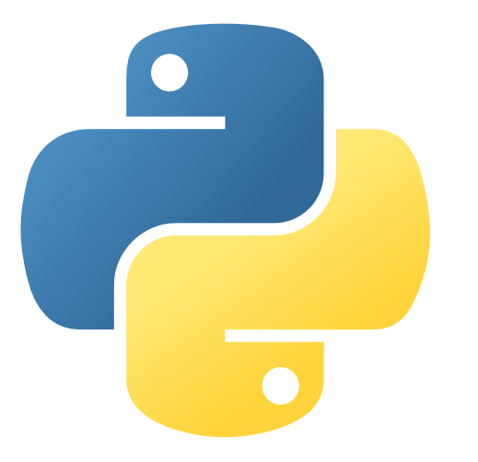






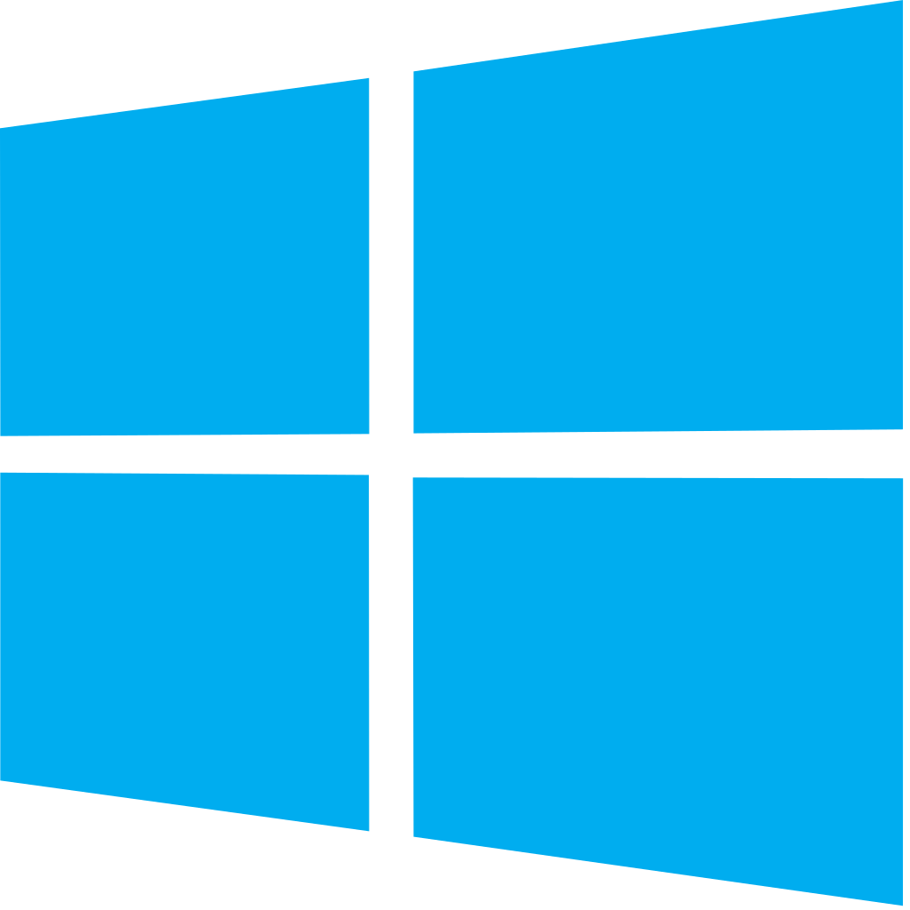


Azure DevOps: Choose what you love
Any Language, Any Platform
Azure DevOps lets
developers
choose the tools and languages that are right for them
Mix and match to create
workflows with tools from Microsoft, open source or your favorite 3rd party tools
Target any cloud, on-prem or both and deploy to the servers you need
@DonovanBrown
Notes:
Azure DevOps is great for any type of application, any platform or any cloud.
You can use them together or with whatever tool or cloud you want. It all depends on what you need.
You want to use Azure Boards to plan, GitHub for your code, Azure Pipelines for CI/CD, Artifactory for storing your artefacts & deploy using Ansible for AWS or GCP… no problem.
Or choose whatever configuration makes sense for you.

Slide 9







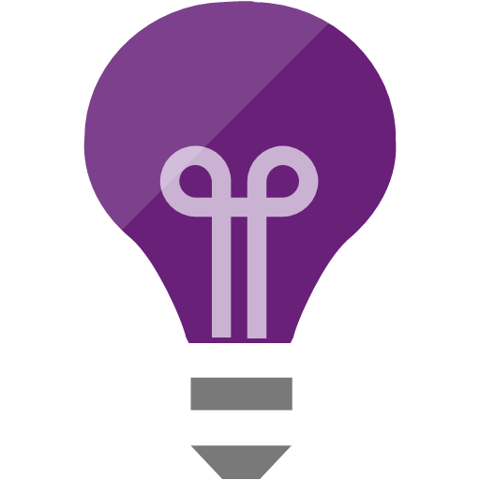



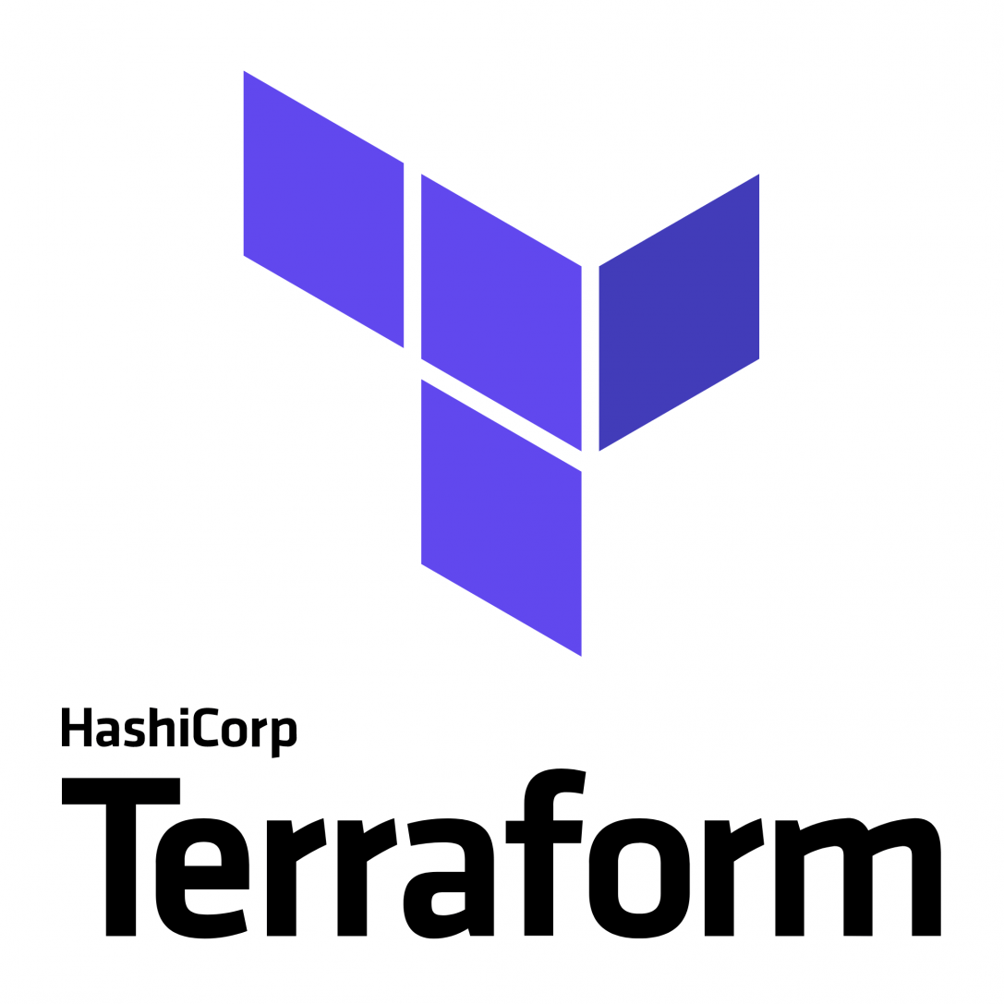

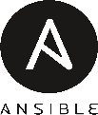


Broadening the Azure Ecosystem
Microsoft
Azure
@DonovanBrown
Notes:
Azure DevOps is really broadening the Azure ecosystem that already includes a rich set of services & technologies and your favourite open source tools.
Say something else clever

Slide 10
Getting Started
#AzureDevOps
Demo
@DonovanBrown
Notes:
https://azure.microsoft.com/en-us/services/devops/?nav=min

Slide 11

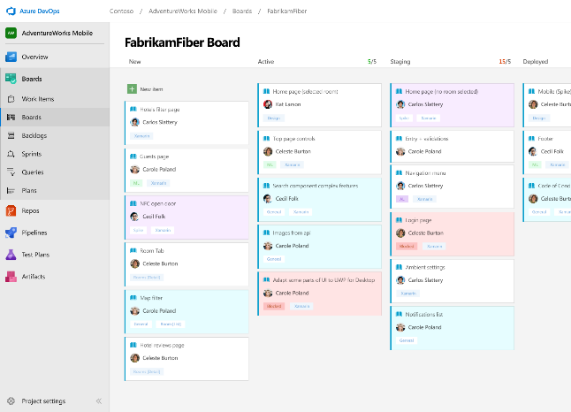



Azure Boards
Track work with Kanban boards, backlogs, team dashboards, and custom reporting
Connected from idea to release
Track all your ideas at every development stage and keep your team aligned with all code changes linked directly to work items.
Scrum ready
Use built-in scrum boards and planning tools to help your teams run sprints, stand-ups, and planning meetings.
Project insights
Gain new insights into the health and status of your project with powerful analytics tools and dashboard widgets.
➔
https://azure.com/devops
@DonovanBrown
Notes:
Combine Kanban boards and drag-and-drop sprint planning with comprehensive traceability and reporting for the perfect home for all your ideas–big and small.

Slide 12
Azure Boards
#AzureDevOps
Demo
@DonovanBrown

Slide 13
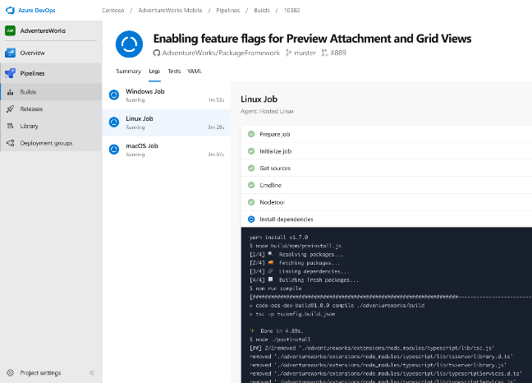


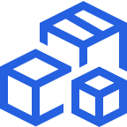
Azure Pipelines
Cloud-hosted pipelines for Linux, Windows and macOS.
Any language, any platform, any cloud
Build, test, and deploy Node.js, Python, Java, PHP, Ruby, C/C++, .NET, Android, and iOS apps. Run in parallel on Linux, macOS, and Windows. Deploy to Azure, AWS, GCP or on-premises
Extensible
Explore and implement a wide range of community-built build, test, and deployment tasks, along with hundreds of extensions from Slack to SonarCloud. Support for YAML, reporting and more
Containers and Kubernetes
Easily build and push images to container registries like Docker Hub and Azure Container Registry. Deploy containers to individual hosts or Kubernetes.
➔
https://azure.com/pipelines
@DonovanBrown
Notes:
(just Jamie)
The What…
Azure Pipelines is our offering for the heart of your DevOps needs… CI/CD… continuous integration & deployment.
Azure Pipelines is the perfect launchpad for your code – automating everything… from your builds and deployments so you spend less time with the nuts and bolts and more time being creative
At Microsoft we do just that. We deploy over 78k times a day with Azure Pipelines.
Open & extensible…
It’s great for any type of application, any platform or any cloud.
It has cloud hosted pools of Linux, Mac & Windows VMs that we manage for you.
Your not restricted to the functionality we provide, Pipelines has rich extensibility. Partners and the community can contribute extensions in our marketplace for everyone
One of my favourite things is when new extensions show up. We have over 500 today, ranging from community built to services from Slack to SonarCloud.
works has rich extensibility with a wide range of community extensions along with
If you want to build & test a Node app in a GitHub repo and deploy it via a docker container to AWS… go for it.
Containers / Modern…
Containers are becoming more & more the unity of deployment & Azure Pipelines is great for containers.
Azure Pipelines can build images, push them to container registries like Docker Hub and Azure Container Registry. You can deploy to any container host including Kubernetes.
Transition…
Donovan, is going to show us Azure Pipelines in action.

Slide 14

Azure Pipelines
Cloud-hosted pipelines for Linux, Windows and macOS, with unlimited minutes for open source
Any language, any platform, any cloud
Build, test, and deploy Node.js, Python, Java, PHP, Ruby, C/C++, .NET, Android, and iOS apps. Run in parallel on Linux, macOS, and Windows. Deploy to Azure, AWS, GCP or on-premises
Extensible
Explore and implement a wide range of community-built build, test, and deployment tasks, along with hundreds of extensions from Slack to SonarCloud. Support for YAML, reporting and more
Containers and Kubernetes
Easily build and push images to container registries like Docker Hub and Azure Container Registry. Deploy containers to individual hosts or Kubernetes.
Best-in-class for open source
Ensure fast continuous integration/continuous delivery (CI/CD) pipelines for every open source project. Get unlimited build minutes for all open source projects with up to 10 free parallel jobs across Linux, macOS and Windows
➔
https://azure.com/pipelines
@DonovanBrown
Notes:
Azure Pipelines is the perfect launchpad for your code – automating your builds and deployments so you spend less time with the nuts and bolts and more time being creative

Slide 15
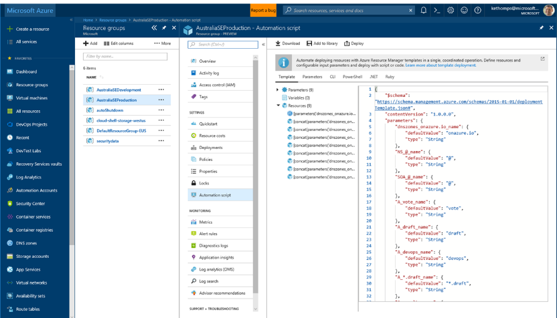
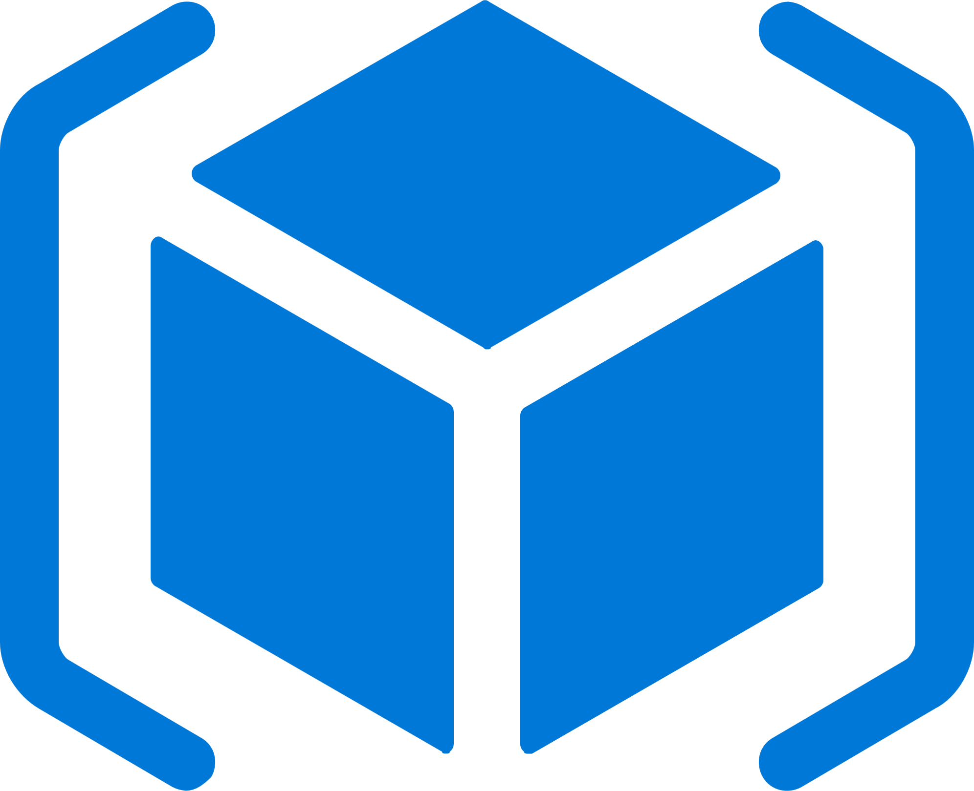
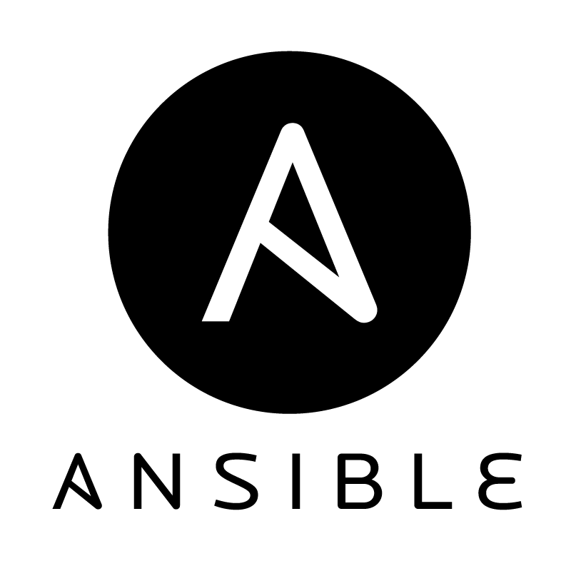


Deploy Repeatedly & Reliably
Azure Resource Manager & DevOps Tool Integrations
Infrastructure as Code, built-in with Azure Resource Manager
Use Azure Automation & Config to automate repetitive tasks
Support for DevOps tool integrations and OSS tooling such as Terraform, Ansible & Chef
@DonovanBrown
Notes:
Deploy repeatedly & reliably using Infrastructure as Code
Azure Resource Manager provides these capabilities for Azure out of the box, and works across Azure as well as Azure Stack
But if you’re already using 3rd party tools such as Terraform, Ansible, Chef, Puppet or SaltStack – we support those too!

Slide 16
Azure Pipelines
#AzureDevOps
Demo
@DonovanBrown

Slide 17
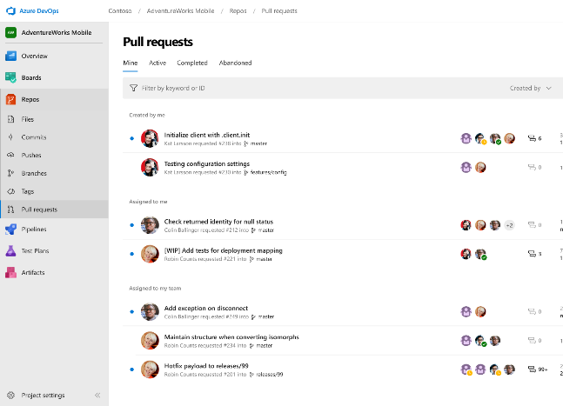



Azure Repos
Unlimited private Git repo hosting and support for TFVC that scales from a hobby project to the world’s largest Git repositories
Works with your Git client
Securely connect with and push code into your Git repos from any IDE, editor, or Git client.
Web hooks and API integration
Add validations and extensions from the marketplace or build your own using web hooks and REST APIs.
Semantic code search
Quickly find what you’re looking for with code-aware search that understands classes and variables.
➔
https://azure.com/devops
@DonovanBrown
Notes:
Collaborate on code changes with threaded discussion and continuous integration for each change. Use forks to promote collaboration with Inner Source workflows.

Slide 18
Azure Repos
#AzureDevOps
Demo
@DonovanBrown

Slide 19
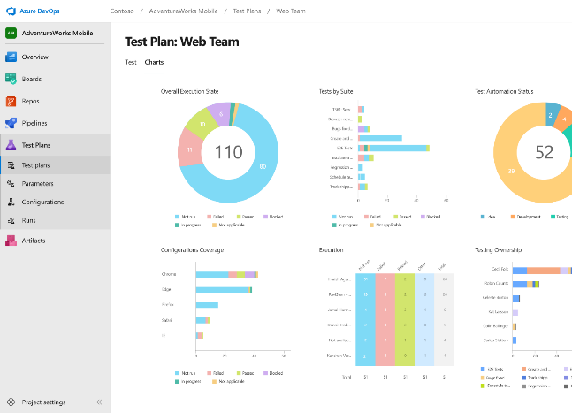
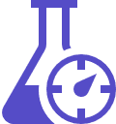


Azure Test Plans
Get end-to-end traceability. Run tests and log defects from your browser. Track and assess quality throughout your testing lifecycle.
Capture rich data
Capture rich scenario data as you execute tests to make discovered defects actionable. Explore user stories without test cases or test steps. You can create test cases directly from your exploratory test sessions.
Test across web and desktop
Test your application where it lives. Complete scripted tests across desktop or web scenarios. Test on-premises application from the cloud and vice-versa.
Get end-to-end traceability
Leverage the same test tools across your engineers and user acceptance testing stakeholders. Pay for the tools only when you need them.
➔
https://azure.com/devops
@DonovanBrown
Notes:
Collaborate on code changes with threaded discussion and continuous integration for each change. Use forks to promote collaboration with Inner Source workflows.

Slide 20
Azure Test Plans
#AzureDevOps
Demo
@DonovanBrown

Slide 21
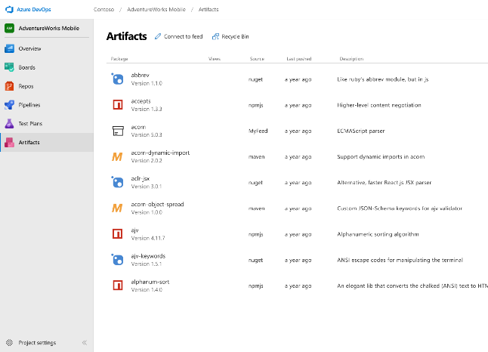



Azure Artifacts
Create and share Maven, npm, and NuGet package feeds from public and private sources – fully integrated into CI/CD pipelines
Manage all package types
Get universal artifact management for Maven, npm, and NuGet.
Add packages to any pipeline
Share packages, and use built-in CI/CD, versioning, and testing.
Share code efficiently
Easily share code across small teams and large enterprises.
➔
https://azure.com/devops
@DonovanBrown
Notes:
Collaborate on code changes with threaded discussion and continuous integration for each change. Use forks to promote collaboration with Inner Source workflows.

Slide 22
Azure Artifacts
#AzureDevOps
Demo
@DonovanBrown

Slide 23










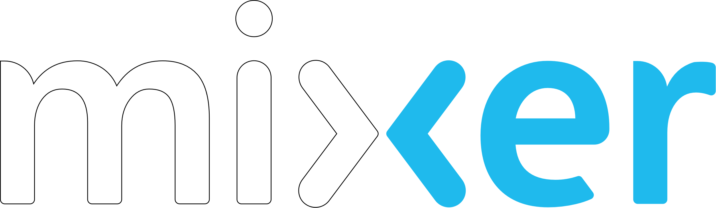
Azure DevOps
Plan smarter, collaborate better, and ship faster with a set of modern dev services
Any developer, any platform, any cloud. Full support for hybrid cloud, on-premises & containers.
Use all the Azure DevOps services or choose just what you need to complement your existing workflows
Best in class builds for open source. Free unlimited build minutes for public projects and up to 10 free concurrent pipelines across Windows, Linux and macOS
Get started for free for small teams, scales to support the largest enterprises
Azure Boards
Azure Repos
Azure Pipelines
➔
https://azure.com/devops
Azure Test Plans
Join us for a community livestream and Q&A
Azure Artifacts
Sept 17th 8:30am Pacific, 11:30am Eastern, 3:30pm UTC
https://aka.ms/AzureDevOpsLaunch
#AzureDevOps
@DonovanBrown
Notes:
Q&A
What’s the pricing?
Free for open source, free for teams up to 5 then around $6 a user after that. Test plans, Artifacts & additional private pipelines - additional charges apply. See Azure pricing calculator for details.
What does this means for existing VSTS customers?
What is happening with TFS?
It’s
Whats the easiest way to get started?
Go to azure.com/devops

Slide 24

“Judge us by the actions we have taken in the recent past, our actions today and in the future”
—Satya Nadella, CEO
Microsoft
2014
2018
@DonovanBrown

Slide 25
Who are we?
League of Extraordinary Cloud DevOps Advocates
  Cloud Developer Advocates
  #LoECDA
@DonovanBrown

Slide 26
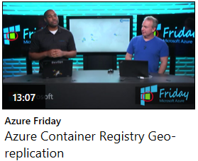
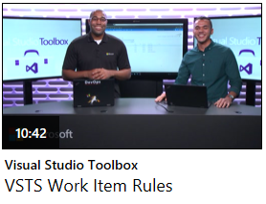
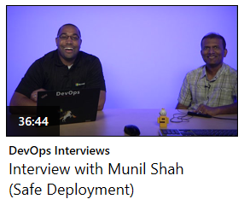
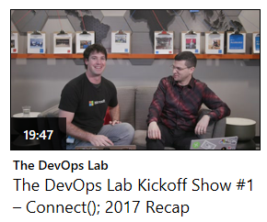

Resources
Channel 9
  Azure Friday
  Visual Studio Toolbox
  DevOps Interviews
  The DevOps Lab
Twitter
  @DonovanBrown
  #LoECDA
Web
  Welcome to DevOps (aka.ms/whatisdevops)
@DonovanBrown

Slide 27
Q&A
@DonovanBrown

Slide 28

Thank You
@DonovanBrown

Slide 29
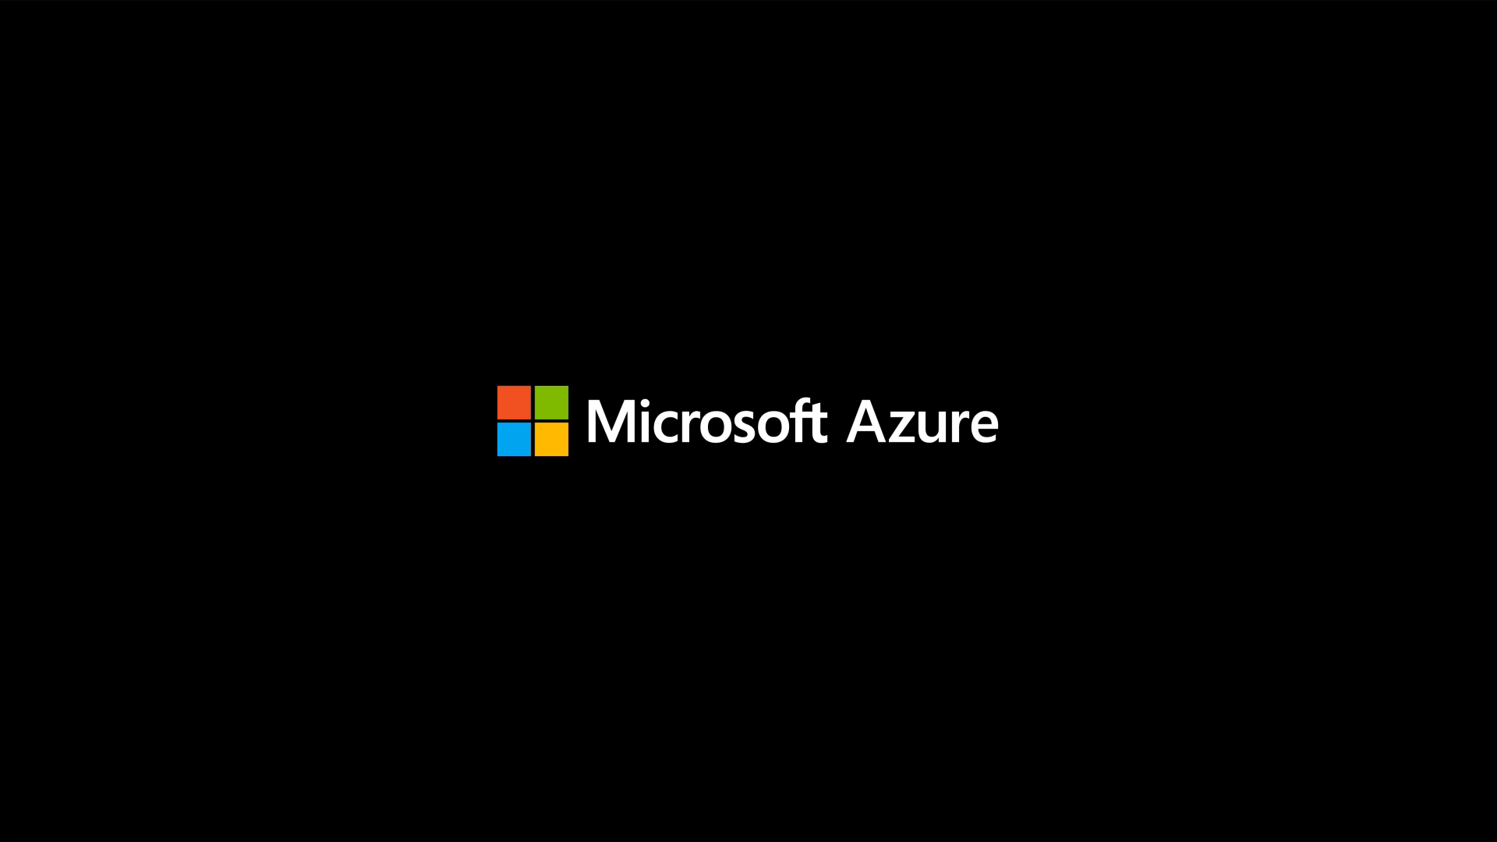
@DonovanBrown

