Slide 1

Azure DevOps Integration
Donovan Brown
@DonovanBrown

Slide 2
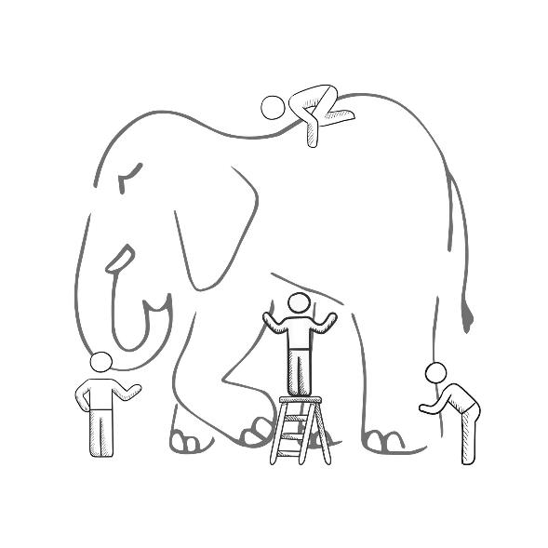
@DonovanBrown
WHAT IS DEVOPS?
It’s a job title
It’s automation
It’s Development and
Operations collaboration
It means faster and smaller releases
Notes:
It was – and still is - the time of Agile and DevOps.
We had to formulate a DevOps strategy for our entire organization.
But what is DevOps? It can mean radically different things for different people!

Slide 3
DevOps is the union of people, process, and products to enable continuous delivery of value to our end users.
@DonovanBrown
Donovan Brown

Slide 4
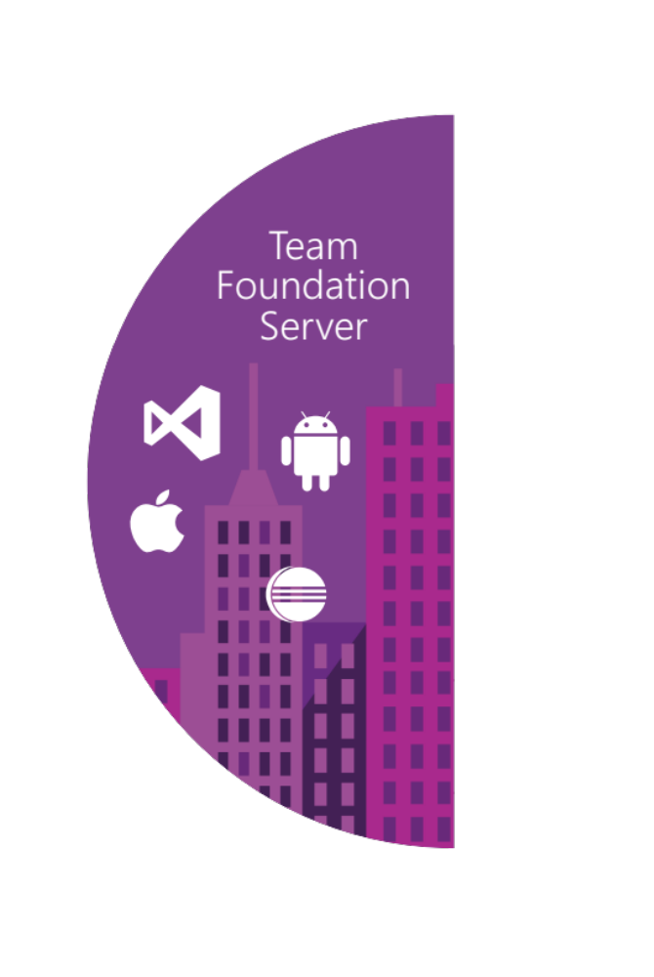
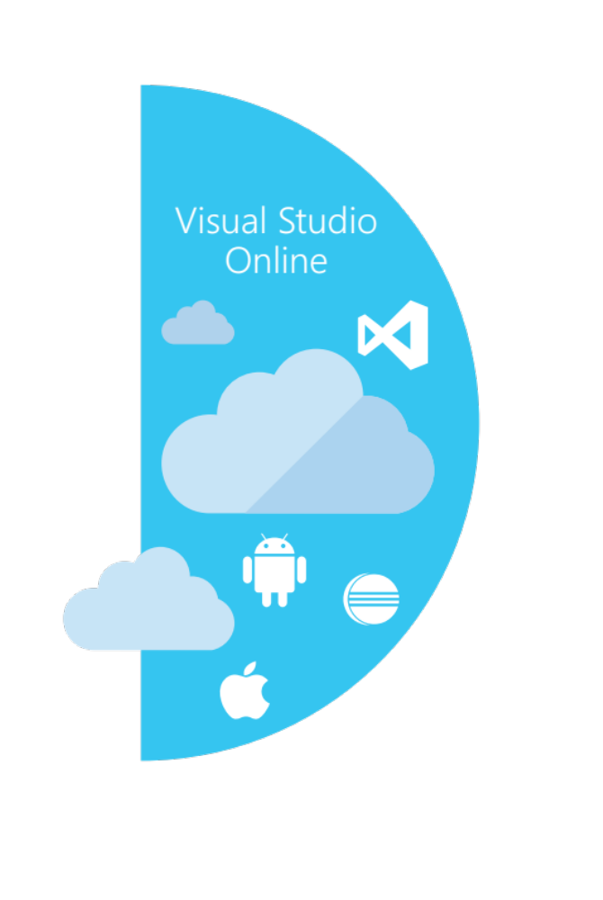






Our solution
@DonovanBrown
Source control
Azure DevOps
Server
Azure DevOps Services
Agile planning
Test case management
Build automation
Continuous deployment
Release management
Load testing
Lab management

Slide 5
Our solution
@DonovanBrown
Source control
Azure DevOps
Server
Azure DevOps Services
Agile planning
Test case management
Build automation
Continuous deployment
Release management
Security Scanning
Feedback management
Team collaboration
Application telemetry
Release Planning

Slide 6
Manage the full stack
@DonovanBrown
Telemetry
Application Insights
Monitor/Learn
Diagnostics
Application Insights
Performance
Application Insights
Notify Approvers
Release Management
Approve
Notify Approvers
Release Management
Manual Tests
Microsoft Test Manager
Test
Automated Tests
Coded UI, Web, Load
Create Test Data
BacPac with SSDT
Configure Application
Tokenization
App
Install Application
NuGet, WebDeploy, etc
Configure Environment
Desired State Configuration
Infra
Provision Environment
Azure Resource Manager
Tracking Work
Azure DevOps
Plan
Planning Work
Azure DevOps

Slide 7

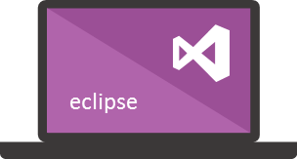
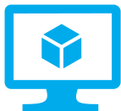





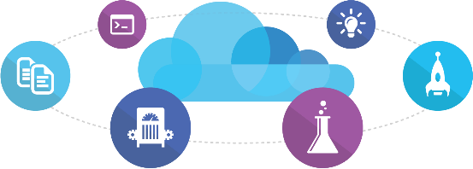
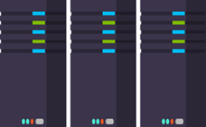
Microsoft
Ecosystem
People | Process | Products
01
02
03
Developer Workstation
Build/CI
04
Release
Develop
Monitor
Build & Test
Azure DevOps
Deploy
Pipelines
Azure Pipelines
Team Collaboration
Monitor & Learn
Test
Automation Service
Azure DevOps
Azure DevOps
PowerShell | WAML
Application Insights
Azure DevOps
Azure Resource Management
Azure Test Plans
Az Command Line
TFS
DEV
TEST
QA
Workstations - On-Premises | Hybrid | Cloud
ALM Services - On-Premises | Hybrid | Cloud
Environments - On-Premises | Hybrid | Cloud
Monitoring - On-Premises | Hybrid | Cloud

Slide 8
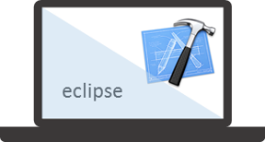


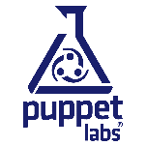




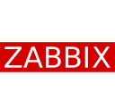





Mixed
Ecosystem
People | Process | Products
01
02
03
Developer Workstation
Build/CI
04
Configuration
Develop
Monitor
Build & Test
Deploy
Team Collaboration
Release
Monitor & Learn
Test
This graphic shows OSS and partner products that are integrated with the Microsoft DevOps solution

Slide 9
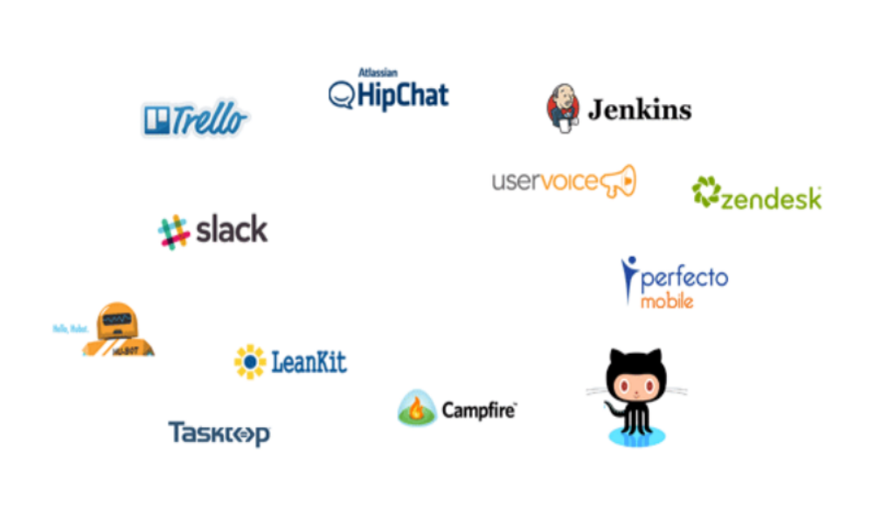

Service Hooks
@DonovanBrown
https://docs.microsoft.com/en-us/azure/devops/extend/develop/add-service-hook?view=azure-devops

Slide 10
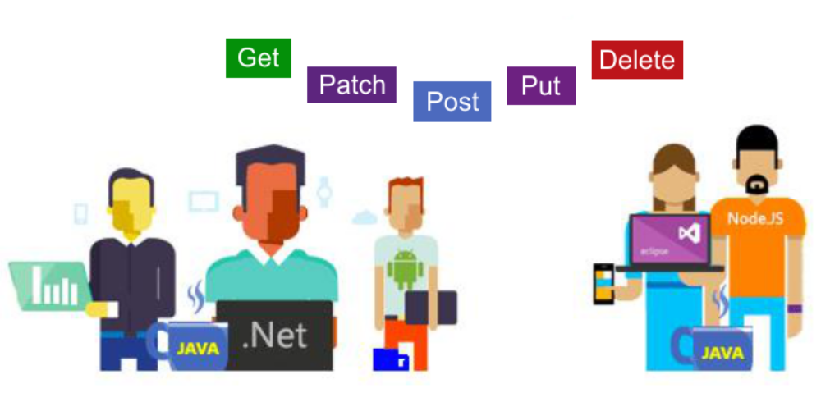
REST APIs
@DonovanBrown
https://docs.microsoft.com/en-us/rest/api/azure/devops/?view=azure-devops-rest-5.0

Slide 11
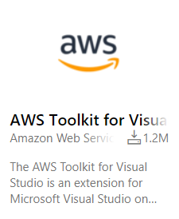
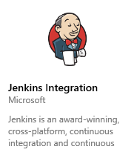
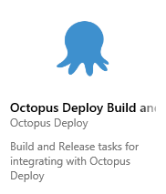
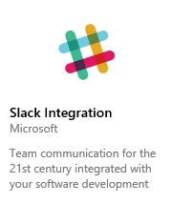
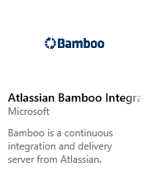
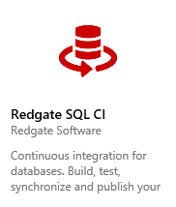

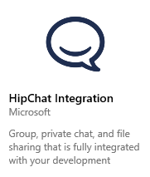
Extensions
@DonovanBrown
https://marketplace.visualstudio.com/azuredevops

Slide 12
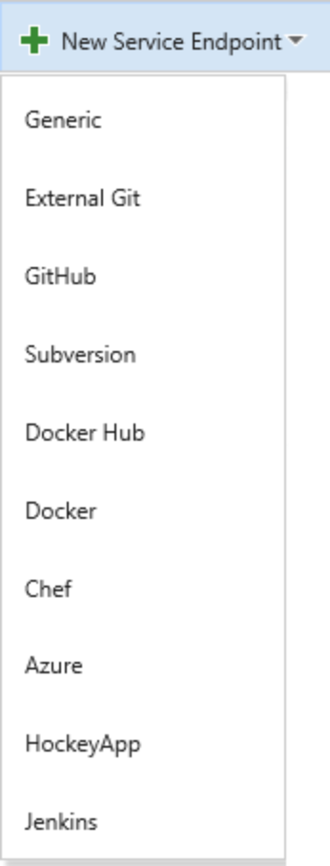
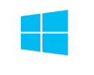






Service Endpoints
@DonovanBrown
https://msdn.microsoft.com/en-us/Library/vs/alm/Release/author-release-definition/understanding-tasks#Serviceendpoints

Slide 13






Any CLI or REST API
@DonovanBrown
https://msdn.microsoft.com/Library/vs/alm/Build/overview

Slide 14




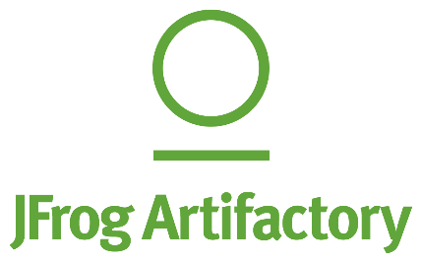










@DonovanBrown
Azure Pipelines

Slide 15
Demo
@DonovanBrown

Slide 16
Questions?
@DonovanBrown

