Slide 1

Mobile DevOps
Donovan Brown
@DonovanBrown

Slide 2

“DevOps is the union of people, process, and products to enable continuous delivery of value to our end users.”
- Donovan Brown
http://bit.ly/WhatIs-DevOps

Slide 3
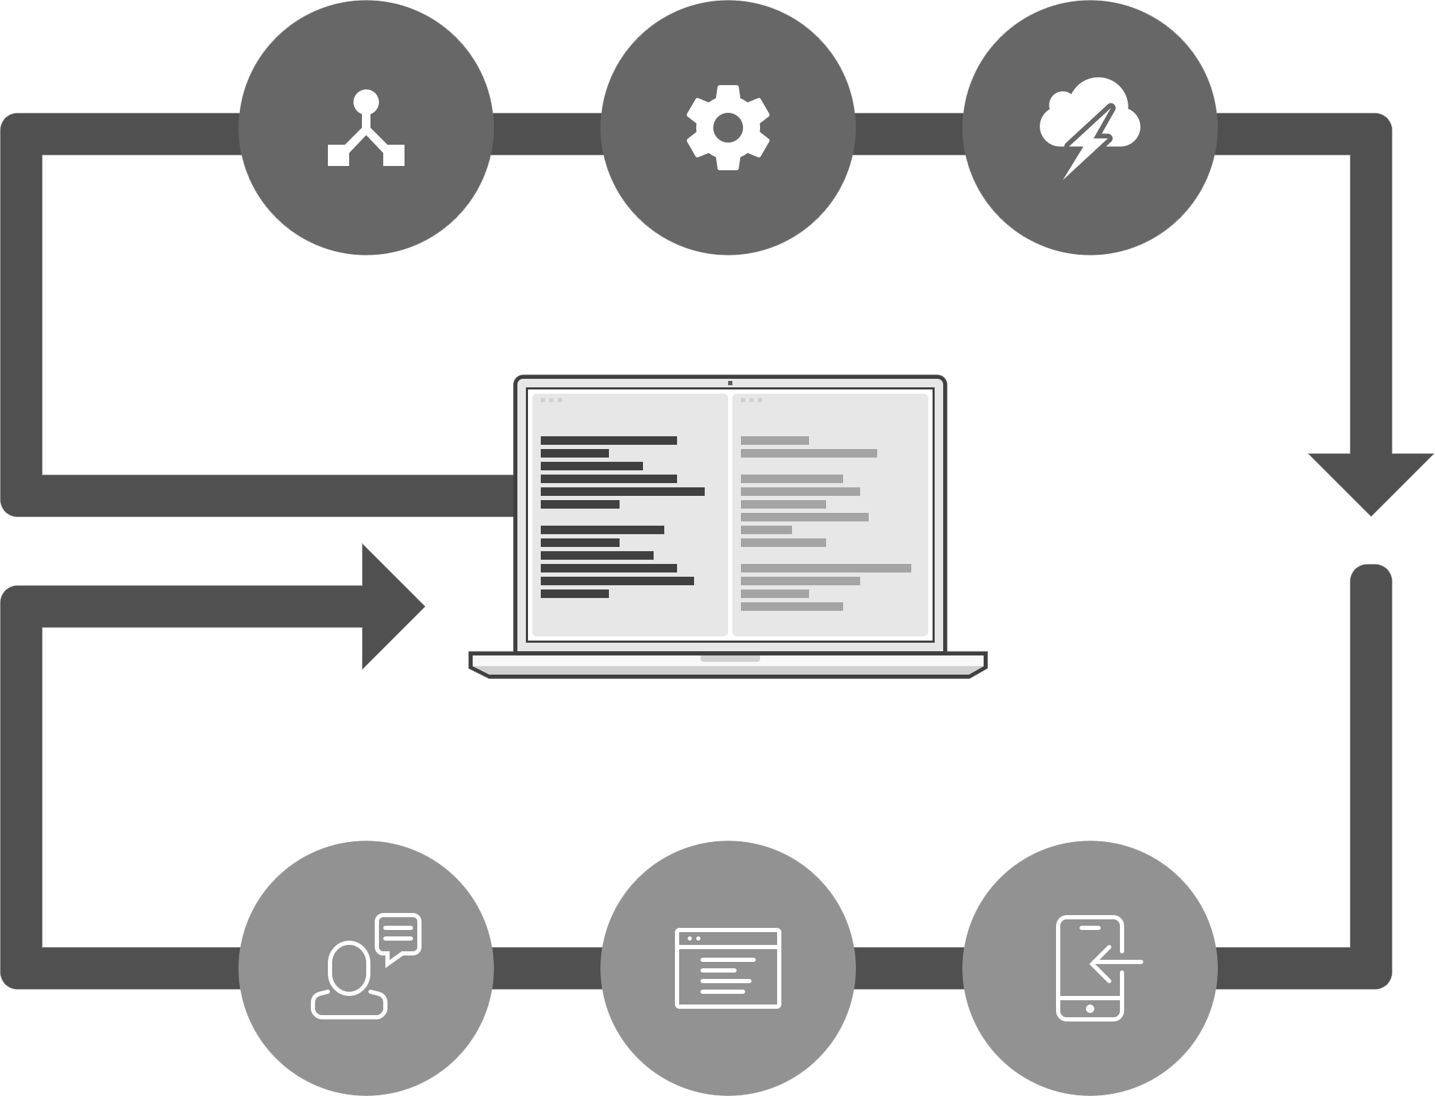
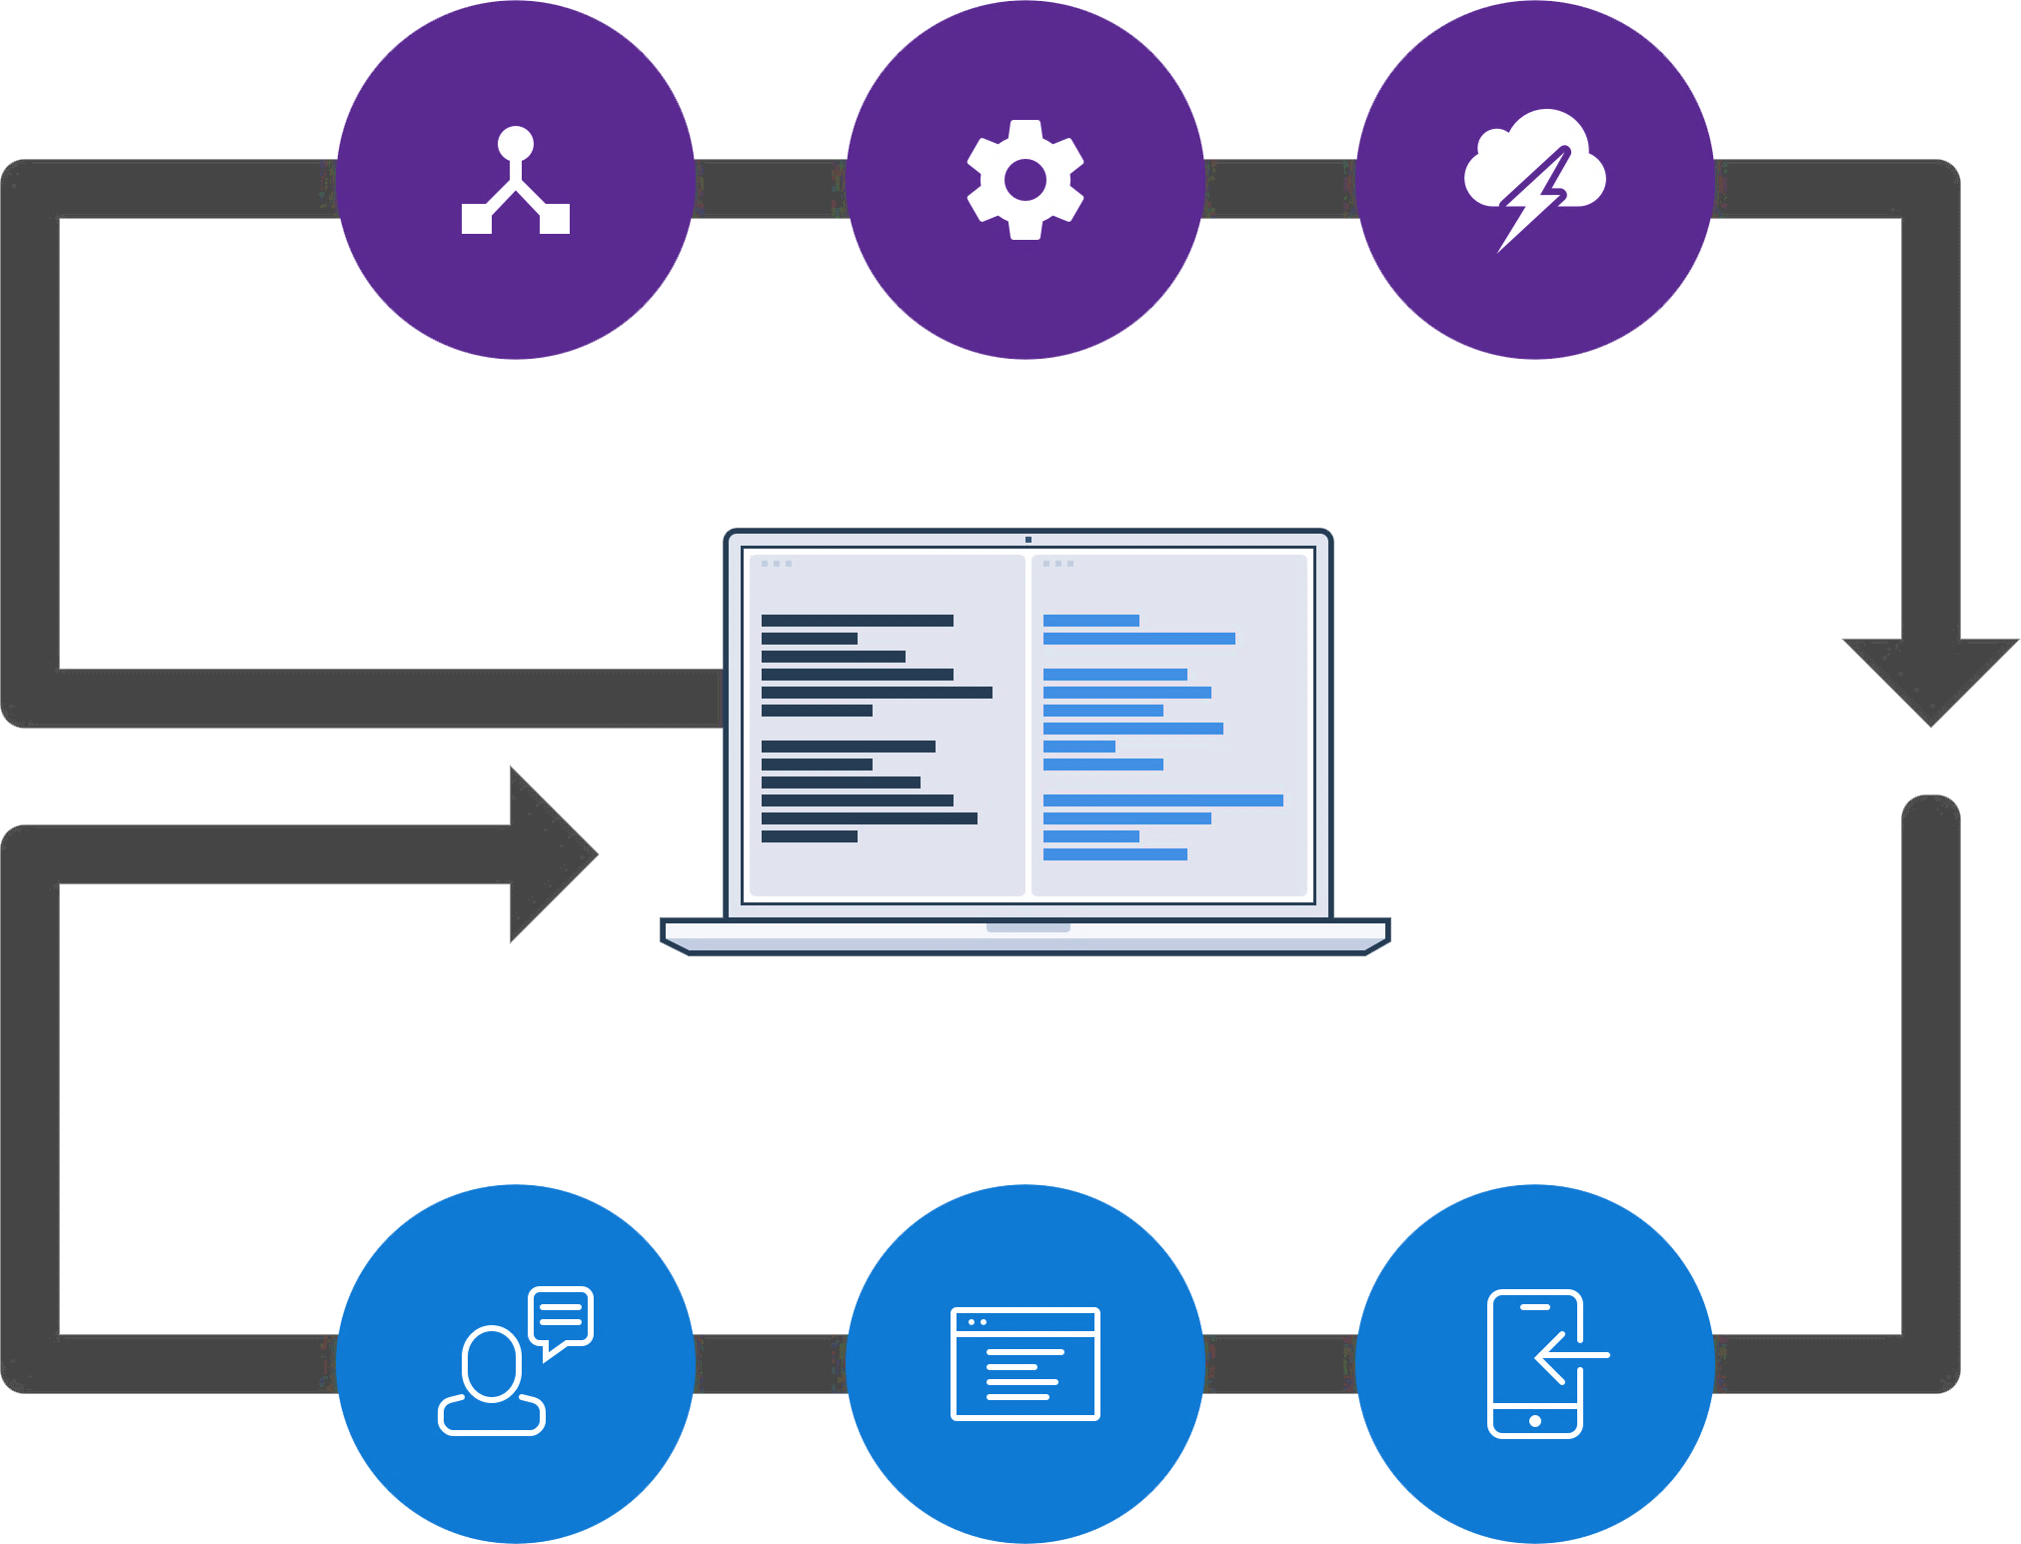
What makes up a “DevOps” pipeline
Streamlining the development of your mobile apps
  Frequently releasing value to users
  Constantly maintaining quality
  Monitoring app health and engagement
  in real-time
Automating the process to be repeatable & sustainable
  Continuous Integration (CI)
  Continuous Delivery (CD)
  Continuous Monitoring (CM)
Repository
Build
Automated Testing
Code
Engagement
Monitoring
Distribution

Slide 4
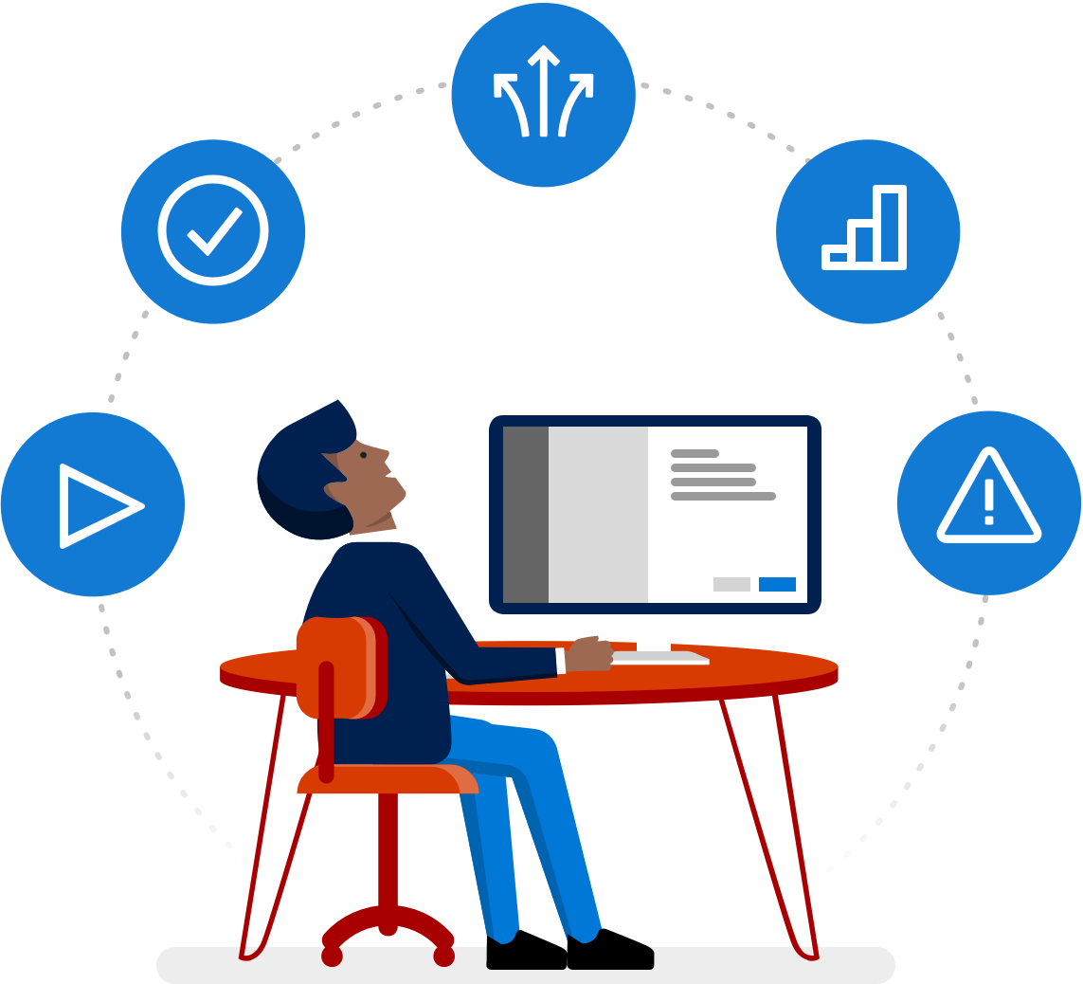
Implement Continuous Everything
Automate your entire mobile app lifecycle

Slide 5
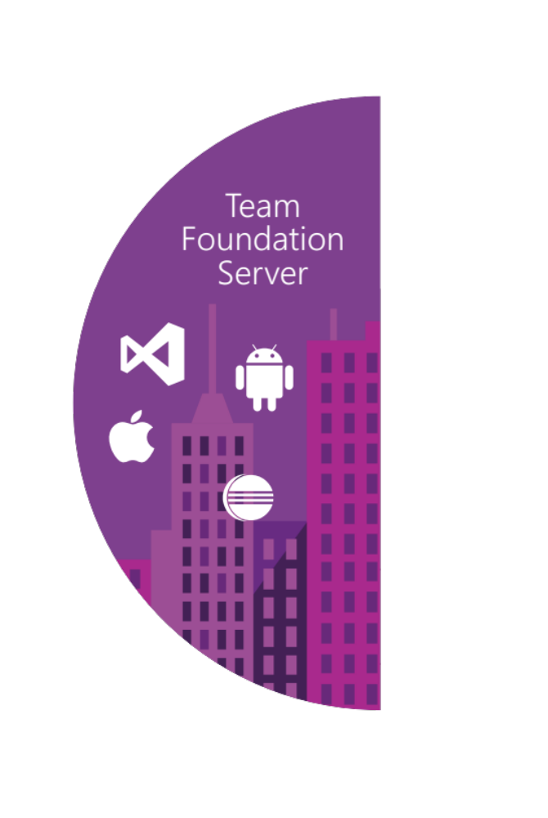
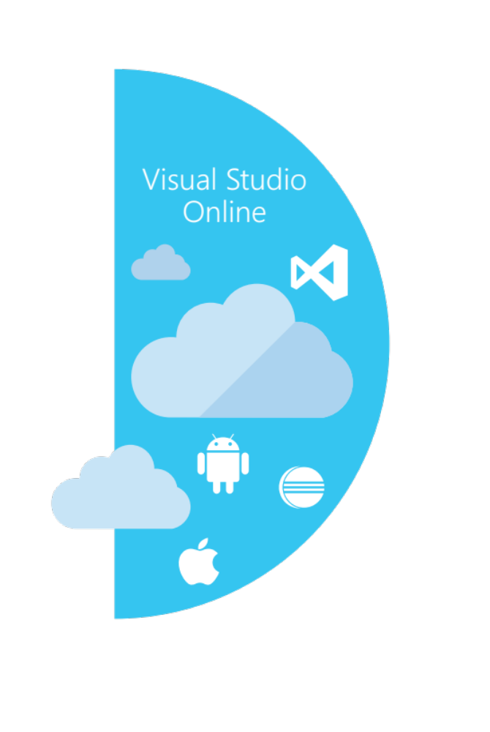
TFS / VSTS
Source control
Team Foundation
Server
Visual Studio
Team Services
Agile planning
Test case management
Build automation
Continuous deployment
Release management
Load testing
Feedback management
Team collaboration
Application telemetry
Lab management

Slide 6
Mobile experiences

Slide 7
The mobile app dilemma
Native
End user experience
Hybrid
Better TCO, productivity and development experience
Notes:
One option is the silo’ed approach – today, it is very common to see a company or developer create the same app multiple times in different languages with different tools for different platforms
While this might give you a fully native user experience and maximum performance, it is also expensive, can require multiple teams and generally takes more time
But the biggest issue of this approach is the future maintenance overhead of managing and maintaining apps and code for multiple different platforms

Slide 8

Cross-platform native with Xamarin
“The best of both worlds”
End User
    Platform-native UX
    Full performance
    Native platform service integration
C#
End user experience
Developer
    100% C# with 100% of platform APIs exposed
    More productivity and faster development
    Up to 95% code reuse across platforms
    Up to 100% shared UI with Xamarin.Forms
    One code base & IDE for client and backend
Better TCO, productivity and development experience
Notes:
Mobile is transformative because mobile apps are context-aware – and context-aware apps require full access to native device capabilities
Mobile users - consumers and employees alike - are more likely to abandon apps that show poor performance or non-standard UI, navigation and controls because it slows them down and forces them to re-learn things they already know
Xamarin takes .NET to the next level and extends it to iOS and Android
Xamarin apps are 100% C# and 100% of Android + iOS platform APIs are exposed
With Xamarin, everything you can do with Objective-C or Java, you can do with .NET
Xamarin apps are 100% native apps, indistinguishable from platform-native apps created with Android Studio, Eclipse or Xcode
Xamarin also includes powerful iOS and Android UI designers that enable you to create beautiful user experiences for Windows, iOS and Android in a visual designer with drag-and-drop simplicity
Xamarin enables developers to use the same languages, libraries, and tools for all major mobile platforms, unlocking the extraordinary productivity of .NET for any iOS and Android while using existing skills and enabling effortless sharing of code among platforms
With Xamarin, you can build native apps once and run them everywhere – giving developers the most productive and powerful platform for creating native cross-platform applications
The cross-platform native approach combines the benefits of both worlds - you get the native user experience for each individual platform, and you also eliminate rework and increase organizational innovation and responsiveness by delivering more apps faster

Slide 9
Development with Xamarin

Slide 10
Continuous Integration

Slide 11
Continuous Integration (CI)
How do you iterate quickly, while still
maintaining quality?
Recommendations
  Setup an automated build server that runs on every check-in
  Author automated tests and run them as part of your build
  Use a test cloud to achieve high device coverage

Slide 12
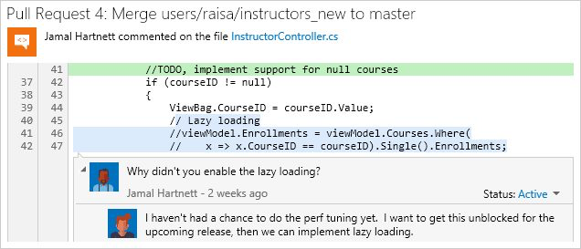
Visual Studio Team Services (VSTS)/TFS
Version control
  Git and Team Foundation version control (TFVC)
  Unlimited private repos
Agile planning
  Work item tracking
  Kanban, backlogs, task boards
Continuous Integration
  Cloud-hosted build agents
  Build support for all mobile platforms
  Integration with test clouds

Slide 13
Continuous Integration with VSTS

Slide 14


Testing in a painful mobile world
Source: Open Signal

Slide 15
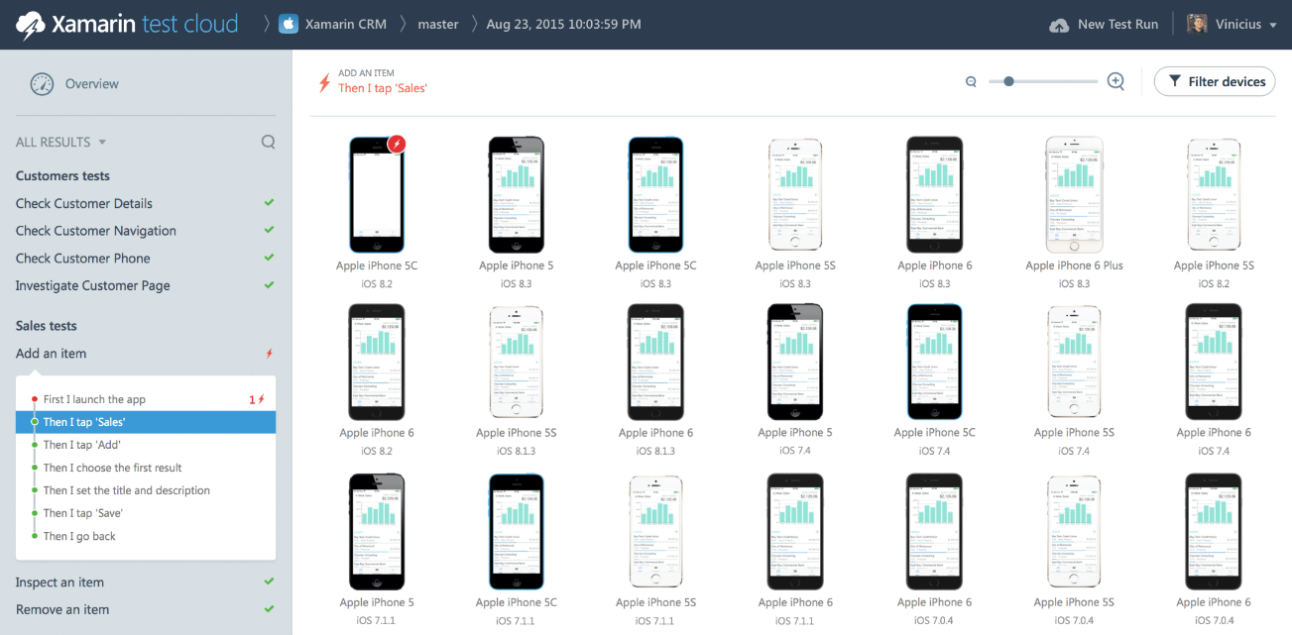
Xamarin test cloud
Cloud device lab
  Manually test with 1,000s of devices
  Provision directly in the browser
VSTS/TFS integration
  Automate uploading new builds
  Parallel test execution

Slide 16
Automated device testing with Xamarin Test Cloud

Slide 17
Continuous Delivery

Slide 18
Extending CI to Continuous Delivery
How can you get early feedback from your users
on every build?
Recommendations
  Conduct a continuous beta program to collect feedback
  Automate the deployment of new builds from your CI server
  Monitor crash reports to catch issues early

Slide 19
HockeyApp
Distribution
  In-house app store
  Notify testers of updates
Crash reporting
  Real-time collection
  “Symbolicated” stacks
Feedback
  Gather in-app feedback
  Respond directly to testers

Slide 20
Distribute your beta with HockeyApp

Slide 21
Release management
How can I release to many locations quickly and still safely?
Recommendations
  Use a consistent process for all environments
  Use the same tools at all stages of release
  Introduce process where you need human intervention

Slide 22
Release management (VSTS/TFS)
Continuous delivery
  Define per-environment release pipeline
  Trigger manually or via successful builds
Approval policies
  Configure per-environment sign-offs
  Manual validation requirements
Release visibility
  View per-environment release status
  Track release back to commits

Slide 23
Release automation for all environments

Slide 24
Continuous Monitoring

Slide 25
Monitor real world use
How can you better understand your users and
how they engage with your app?
Recommendations
  Collect feedback from your end users, talk directly to them.
  Crash line
  Track Daily/Monthly Active Users (DAU/MAU) to understand user acquisition and retention
  Instrument your app with custom events to better understand user engagement of specific features

Slide 26
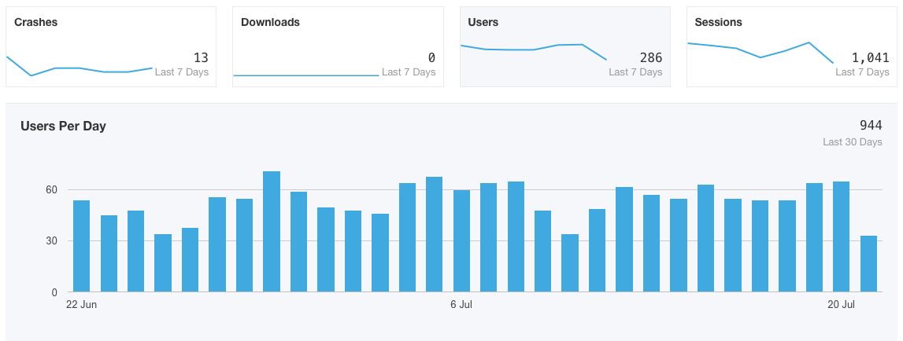
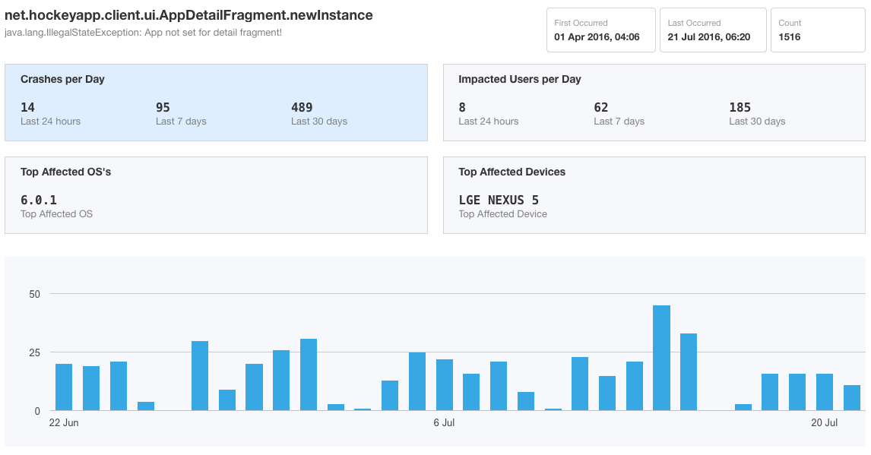
HockeyApp
Monitoring
  SDK tracks crashes, users, sessions,
  custom events
  Fully symbolicated crash reports
  Features can be individually disabled
Data access
  Aggregated metrics as counts and charts
  Crash logs, descriptions and attachments
  Raw events through Application Insights

Slide 27
Continuous Monitoring with HockeyApp

Slide 28




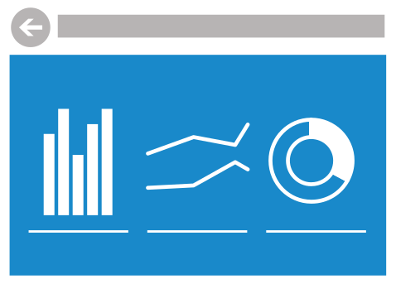





Mobile app continuous delivery with Microsoft
Code Repository | Build + Deploy
App Testing
Beta Testing
Visual Studio
Team Services
Backlog
Telemetry Collection
Users and customers install and use app
Application Insights
Monitor and improve

Slide 29


Live Update
Crash Reporting
Storage
Push Notifications
Identity
Tables

Slide 30
Push Notifications
Visual Studio Mobile Center
Mission control for mobile apps
Crash Reporting
Tables
Live Update
Identity
Storage

Slide 31
Visual Studio Mobile Center
Automate your entire mobile app lifecycle in a few easy steps
Deliver high-quality apps that keep users coming back for more
Move faster and increase quality with the tools you already use—we support a wide variety of platforms

Slide 32

Please complete survey http://aka.ms/vstsmeetups

