Slide 1
The Microsoft DevOps Vision
Donovan Brown

Slide 2
Session Objectives And Takeaways
Session Objective(s):
  Show how Microsoft’s tools address DevOps practices
  We will tour the products but not full E2E demos that is my other session
Microsoft is a key player in the DevOps space
Our tools enable teams regardless of the technology they use or the platform they target
Notes:
We are a cross-platform tool
This slide is required. Do NOT delete. This should be the first slide after your Title Slide. This is an important year and we need to arm our attendees with the information they can use to Grow Share! Please ensure that your objectives are SMART (defined below) and that they will enable them to go in and win against the competition to grow share. If you have questions, please contact your Track PM for guidance. We have also posted guidance on writing good objectives, out on the Speaker Portal (https://www.mytechready.com).
This slide should introduce the session by identifying how this information helps the attendee, partners and customers be more successful. Why is this content important?
This slide should call out what’s important about the session (sort of the why should we care, why is this important and how will it help our customers/partners be successful) as well as the key takeaways/objectives associated with the session. Call out what attendees will be able to execute on using the information gained in this session. What will they be able to walk away from this session and execute on with their customers.
Good Objectives should be SMART (specific, measurable, achievable, realistic, time-bound). Focus on the key takeaways and why this information is important to the attendee, our partners and our customers.
Each session has objectives defined and published on www.mytechready.com, please work with your Track PM to call these out here in the slide deck.
If you have questions, please contact your Track PM. See slide 5 in this template for a complete list of Tracks and TPMs.

Slide 3

It’s DevOps!
It’s DevOps!
It’s DevOps!
It’s DevOps!

Slide 4
“DevOps is the union of people, process, and products to enable continuous delivery of value to our end users.”
Donovan Brown
http://bit.ly/WhatIs-DevOps

Slide 5
How we became agile and transformed a box software product into a service…

Slide 6


The journey
TFS
2005
TFS
2008
TFS
2010
TFS
2012
TFS
2013
TFS
U1
TFS
U2
TFS
U3
TFS
U4
TFS
U5
TFS
2015
Visual Studio
Notes:
It took 3 years to actually write TFS 2005. 18 months of development and another 18 months fixing it to ship. It actually took so long that TFS 2005 actually did not ship until Feb of 2006!
We were able to take a delivery cycle and reduce it from 3 years to 3 months. But we were not done yet. DevOps is the only journey that you embark on knowing there is no end and that is what is exciting about it. When we decided to move to the cloud we now update the service every three weeks.

Slide 7
Our roles
Program Manager – Responsible to ensure we’re building
the right thing.
Engineer – Responsible to ensure we’re building products that are fast, reliable, and well engineered AND high quality and meets customers needs.
Notes:
PMs - in scrum are the product owners. Set the priorities. Can differentiate between customer wants and needs. And apologize for what we're not going to do
Engineer - 6 months ago, I would have been describing
A lot of waste in the work. 2 week dev milestone, 1 week test milestone. It was unhealthy.
You found testers log a lot of bugs, but they didn't feel accountable for fixing the product
Hard to recruit talent in to test discipline
Engineers feel more empowered
You would know a change that needed to be done would get the answer "the test cost is too high". We got so good at automation that if you wanted to make a huge change it would break too many tests

Slide 8
Our teams
Program Management
Engineering
Notes:
The way we run our business is through teams
Teams
Self-managing. Describe my team names and make-up
It's Gregg that has the autonomy - he makes decisions, he makes organization of stories (product management, business analyst)
Stay intact for about 12-18 months. Like a team sports -- need to learn to play together
2 years ago we moved out of office. Eng manager used to sit in office next door, might have gone by and seen door close

Slide 9
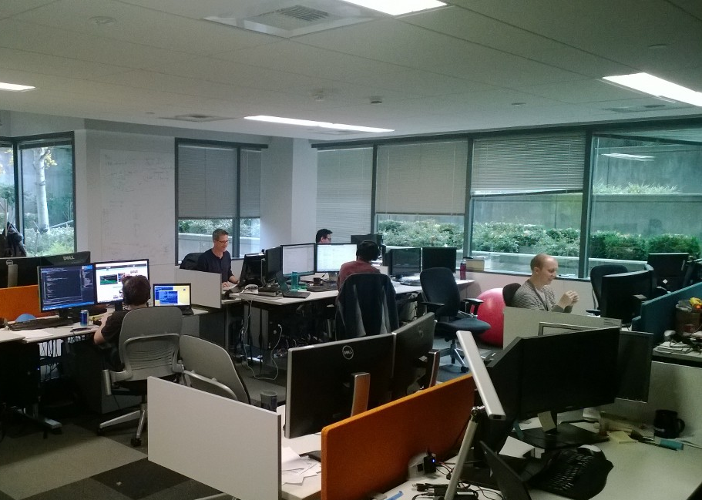
Teams
Cross discipline
10-12 people
Self managing
Autonomous backlog
Intact for 12-18 months
Physical team rooms
Notes:
These teams are cross-discipline and have a fair amount of autonomy over an area of the product. Each team has a PM, Dev Lead, and Test Lead. They represent a “triad” which is the decision making body of the team.
Could touch on Dan Pink’s book Drive here
Autonomy
Mastery
Purpose

Slide 10
3 week sprints
3 weeks

Slide 11
3 week sprints
Deployment
Sprint Planning
Done!
Week 1
Week 2
Week 3
Sprint 68
Sprint 69
Sprint 70
Week 1
Week 2
Week 3
Week 1
Week 2
Week 3
Notes:
One day of planning

Slide 12
3 week sprints
The sprint plan
What we accomplished
Week 1
Week 2
Week 3
Sprint 85
Sprint 86
Sprint 87
Week 1
Week 2
Week 3
Week 1
Week 2
Week 3

Slide 13
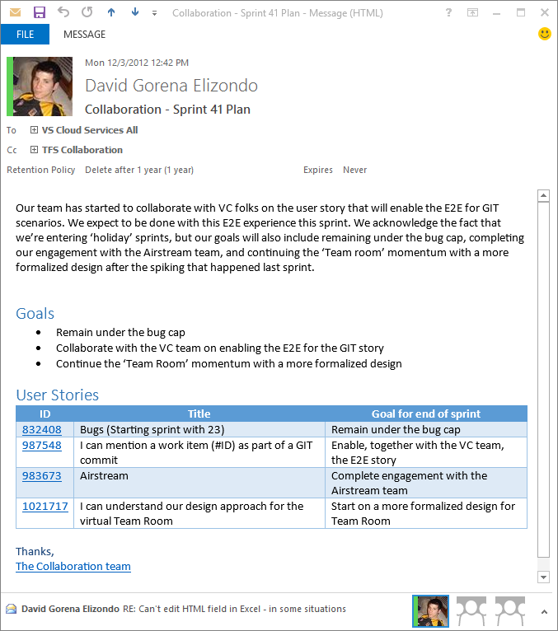
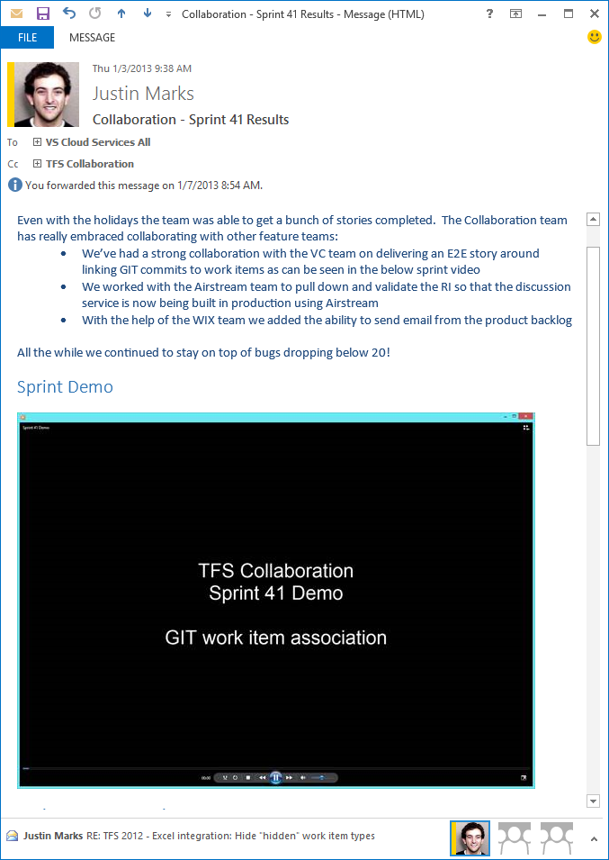
Sprint mails
Plan
Accomplished

Slide 14
Quality before
Code
Complete
Code
Test & Stabilize
Code
Test & Stabilize

Slide 15
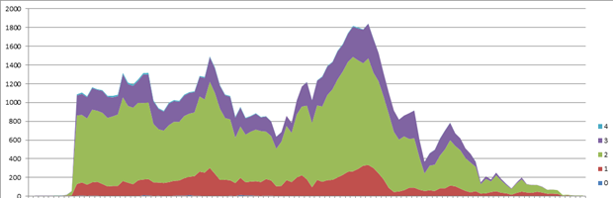
Quality before
Multi-year cycles
Milestones and stabilizations
Debt

Slide 16
Quality after
Notes:
Bug cap is 5 per engineer to control debt

Slide 17
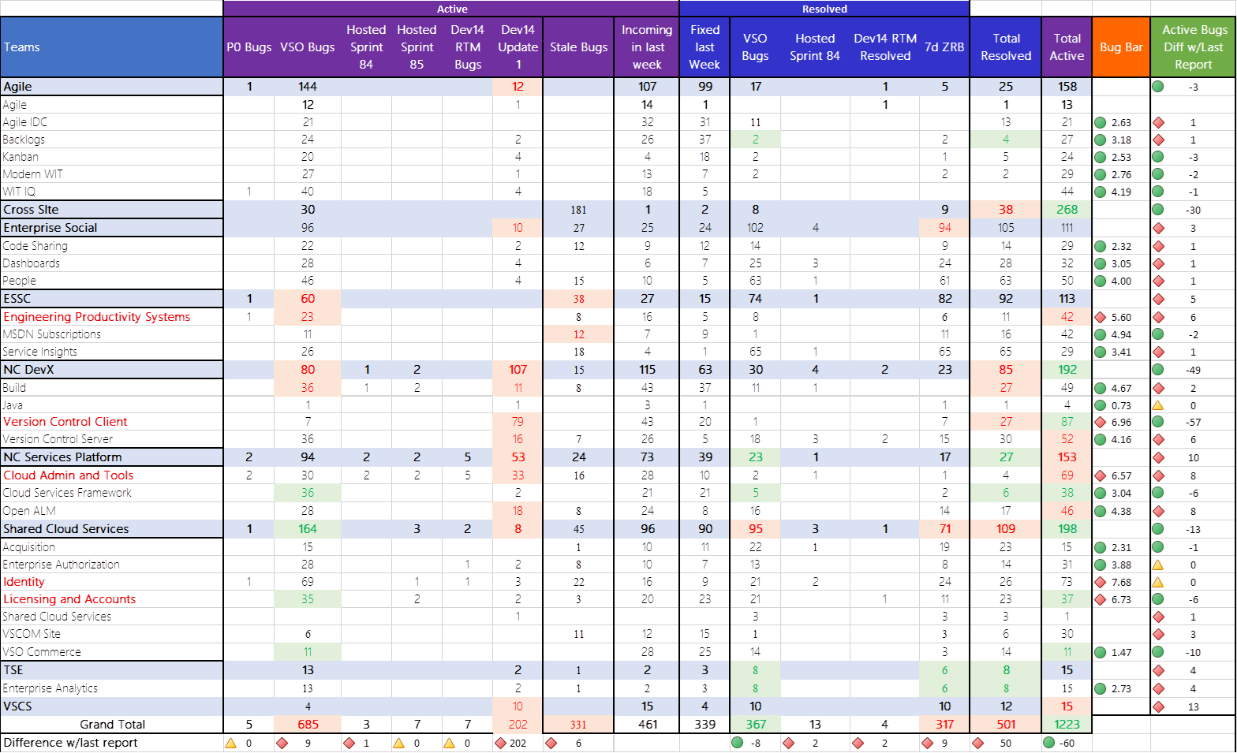
Bugs

Slide 18
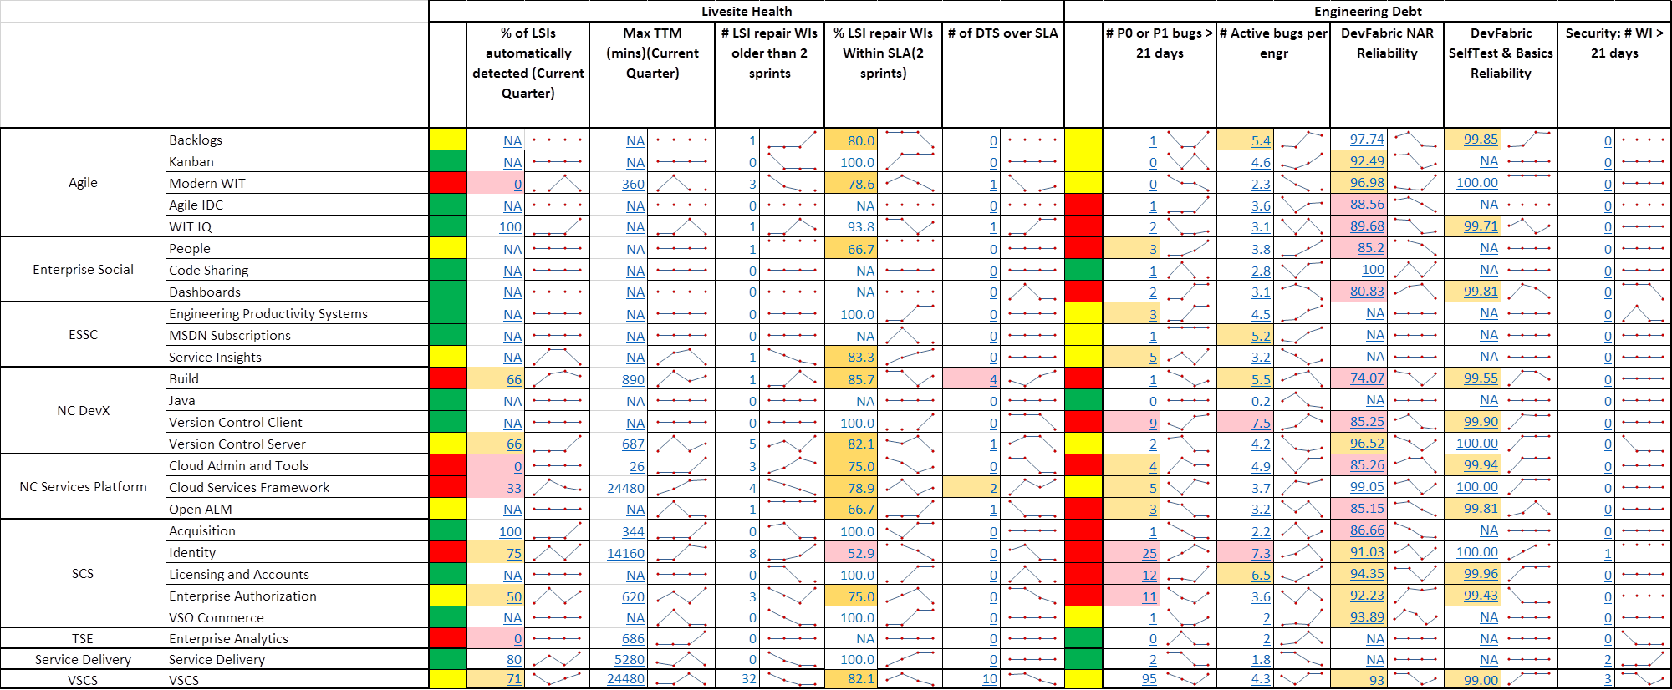
Engineering scorecard

Slide 19
Transform engineering
Multi-year cycles → cloud cadence
Box → live site/DevOps
On-premises TFS → Visual Studio Team Services
Dev and QA → engineer
Mostly functional tests → mostly unit
Accepting test failures → 100% reliability and fast

Slide 20
Deployment principles
No down time
Fully automated
Joint ownership between engineering and ops
Decoupled services: clear contracts
Feature flags

Slide 21
Feature flags
Decouples engineering and marketing
Control exposure
Granular
Controlled via PowerShell
Supports early feedback, experimentation
Conferences, launches

Slide 22
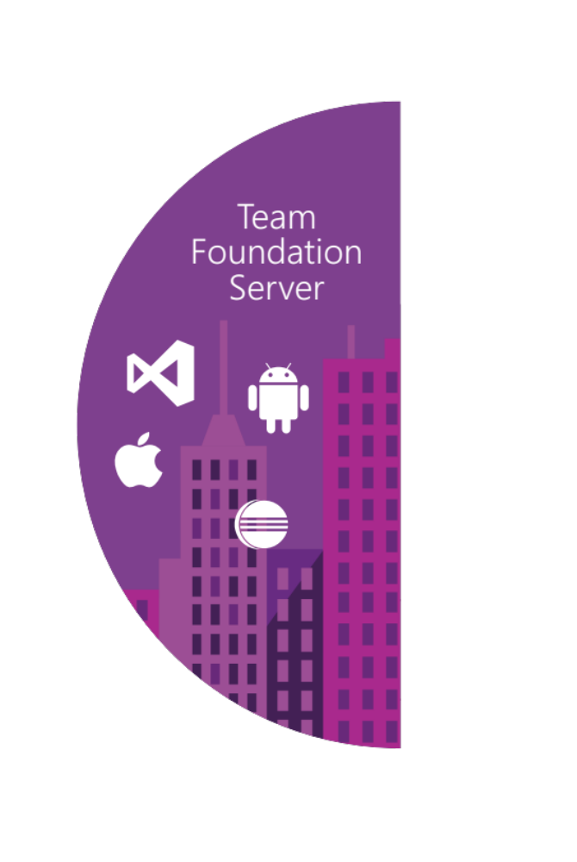
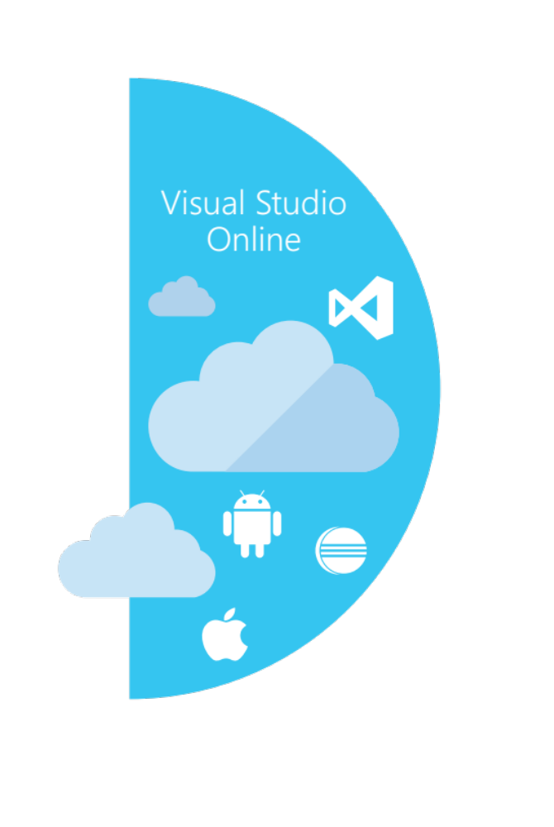





Our solution
Source control
Team Foundation
Server
Visual Studio
Team Services
Agile planning
Test case management
Build automation
Continuous deployment
Release management
Load testing
Lab management

Slide 23
Our solution
Source control
Team Foundation
Server
Visual Studio
Team Services
Agile planning
Test case management
Build automation
Continuous deployment
Release management
Load testing
Feedback management
Team collaboration
Application telemetry
Lab management

Slide 24
Manage the full stack
Telemetry
Application Insights
Monitor/Learn
Diagnostics
Application Insights
Performance
Application Insights
Notify Approvers
Release Management
Approve
Notify Approvers
Release Management
Manual Tests
Microsoft Test Manager
Test
Automated Tests
Coded UI, Web, Load
Create Test Data
BacPac with SSDT
Configure Application
Tokenization
App
Install Application
NuGet, WebDeploy, etc
Configure Environment
Desired State Configuration
Infra
Provision Environment
Azure Resource Manager
Tracking Work
TFS / VSTS
Plan
Planning Work
TFS / VSTS

Slide 25








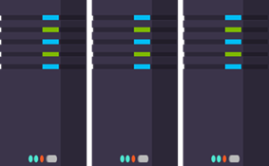
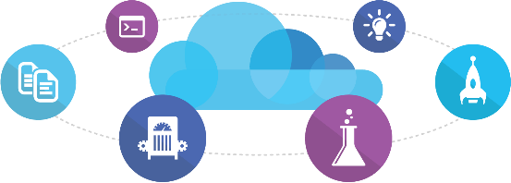
Microsoft
Ecosystem
People | Process | Tools
01
02
03
Developer Workstation
Build/CI
04
Release
Develop
Monitor
Build & Test
TFS / VSTS
Deploy
Release Management
for Visual Studio
Release Management
for Visual Studio
Team Collaboration
Monitor & Learn
Test
Automation Service
VSTS
TFS / VSTS
PowerShell | WAML
Application Insights
TFS / VSTS
Azure Resource Management
Microsoft Test Manager
xPlat Command Line
TFS
DEV
TEST
QA
Workstations - On-Premises | Hybrid | Cloud
ALM Services - On-Premises | Hybrid | Cloud
Environments - On-Premises | Hybrid | Cloud
Monitoring - On-Premises | Hybrid | Cloud

Slide 26














Mixed
Ecosystem
People | Process | Tools
01
02
03
Developer Workstation
Build/CI
04
Configuration
Develop
Monitor
Build & Test
Deploy
Team Collaboration
Release
Monitor & Learn
Test
This graphic shows OSS and partner products that are integrated with the Microsoft DevOps solution

Slide 27
List of DevOps Practices
Infrastructure as Code (IaC)
Continuous Integration
Automated Testing
Continuous Deployment
Release Management
App Performance Monitoring
Load Testing & Auto-Scale
Availability Monitoring
Capacity Management
Change/Configuration Management
Feature Flags
Automated Environment De-Provisioning
Self Service Environments
Automated Recovery (Rollback & Roll-Forward)
Hypothesis Driven Development
  Testing in Production
  Fault Injection
  Usage Monitoring / User Telemetry
http://www.itproguy.com/devops-practices/

Slide 28




DevOps
1
4
Plan
Monitor + Learn
Development
Production
2
3
Develop + Test
Release

Slide 29

Plan
It starts with an idea – and a plan how to turn this idea into reality …
Project starts
Manage work
Develop + Test
1
Track progress
Plan

Slide 30
Kanban

Slide 31

Develop + Test
Once the iteration starts, developers turn great ideas into features …
2
Write Code
Unit Testing
Version Control
Build
Build Verification
Release

Slide 32
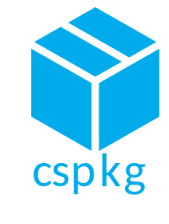
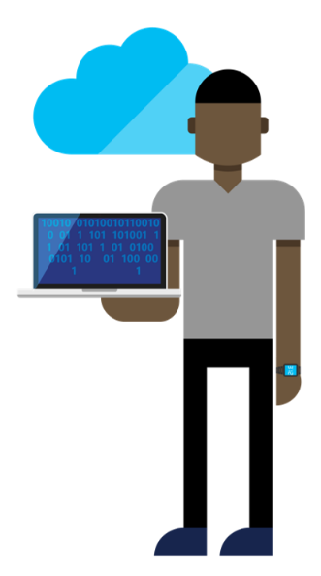


Continuous Integration
Source
Build
Value
Accelerate Delivery
Repeatability
Optimized Resources
Test
Measure
More frequent releases
MTTR
MTTD
DEV
OPS
OPS

Slide 33
Continuous Integration

Slide 34


Release
When all tests pass, the build is deployed to testing environments for each stage in the release process
Cloud
Load Testing
Integration testing
environment
Staging
environment
3
Monitor + Learn
Automated functional testing environment
Pre-production environment

Slide 35
Release Management
SOURCE REPO
DEV
Value
Optimized Resources
Accelerate Delivery
STAGE
Measure
Deployment Rate
MTTR
Availability
PRODUCTION
DEV
OPS
Notes:
David Note: Make sure to highlight customer pain points, “bullet train”, Poll??

Slide 36
Continuous Deployment & Release Management

Slide 37
Monitor + Learn
Learn and understand how users use your app, how it reacts and quickly fix issues and bugs
Plan the next iteration
Feedback
Monitor
4

Slide 38


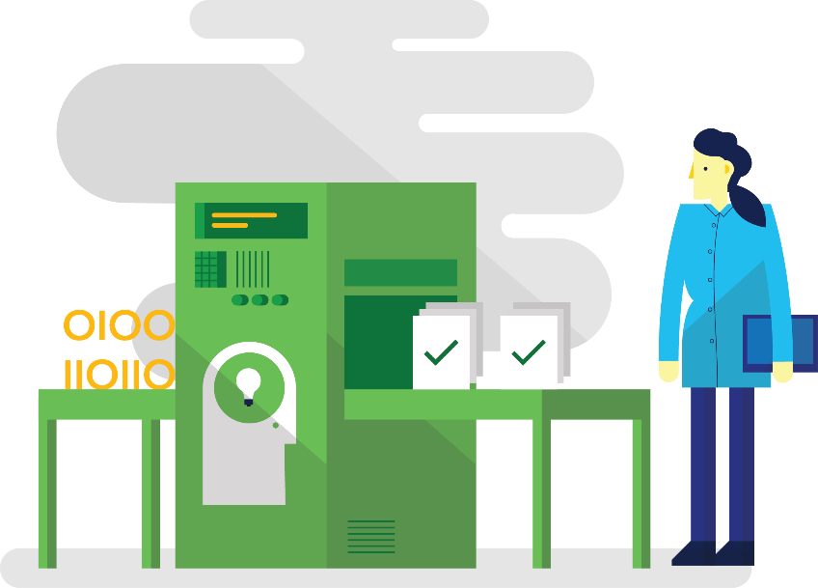

Monitor and Learn
Testing in Production
Telemetry
Fault Injection
PRODUCTION A
PRODUCTION B
PRODUCTION
X
90%
10%
X
X
X

