Slide 1
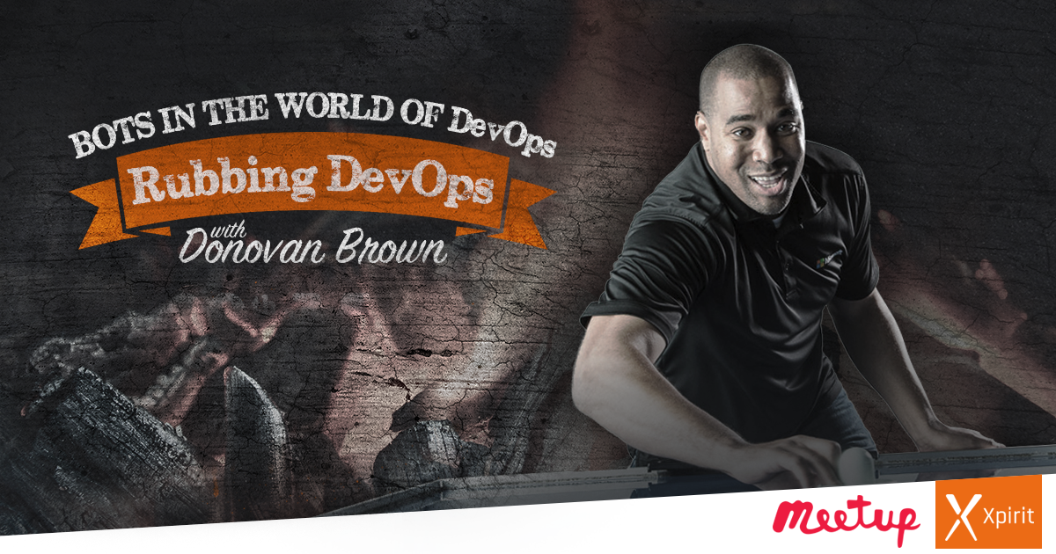

Slide 2
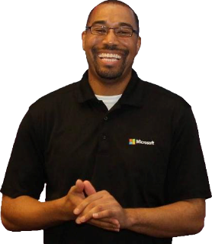
Bots & DevOps
Donovan Brown
@DonovanBrown

Slide 3
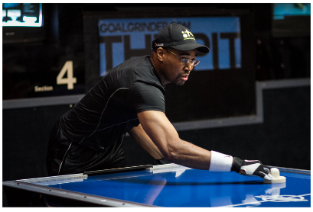
Who am I?
Donovan Brown | @DonovanBrown
  Principal DevOps Manager
  Blog at DonovanBrown.com
  Technical YouTube Channel
    tinyurl.com/DonovanBrown
Fun Stuff
  Professional Air Hockey player
    Highest ranking 11th in the world
  Competitive driver
  Developer for over 20 years

Slide 4
aka.ms/vstsmeetups

Slide 5
Session objectives and takeaways
Session objectives:
  Introduce the concepts of DevOps, with considerations for bots
  Demonstrate how to implement these DevOps practices for bots that use the Microsoft Bot Framework
Session takeaways:
  DevOps culture and practices can be applied everywhere
  Microsoft Bot Framework makes it easy to build, automate, test, and deploy bots

Slide 6
Bots aren’t new – why are they blowing up?
Convergence of technologies
Tools and intelligent services make building powerful bots accessible
Ubiquity of communication channels
App boom is slowing (and top apps are chat apps!)

Slide 7
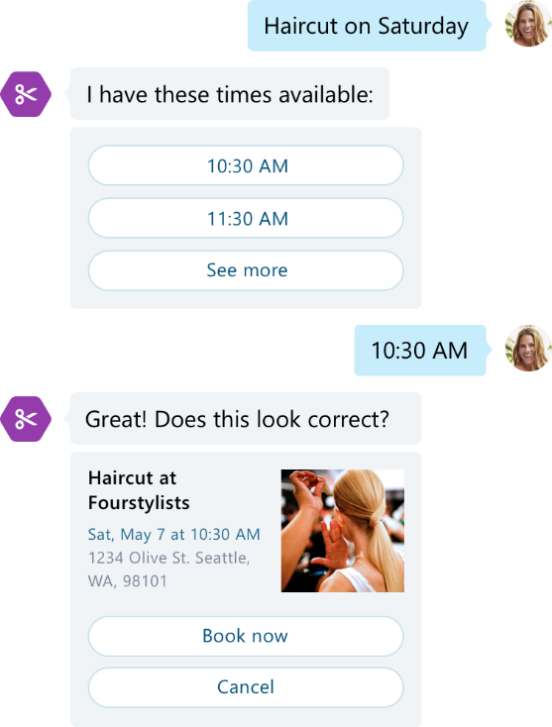
Bots are not artificial intelligence only

Slide 8
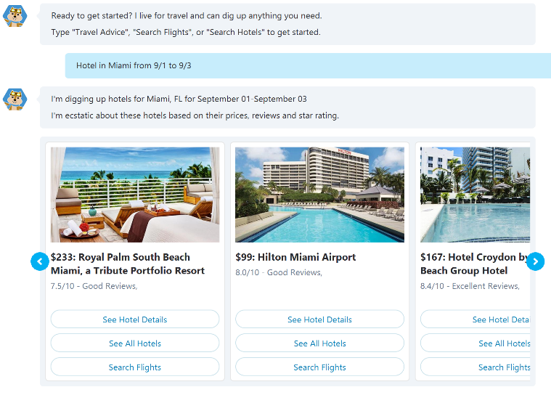
Bots are not text interface only

Slide 9







What are Bots?
Bots are apps with a new interface that provide more natural interactions
Your Data
Connector
State
Other
Services

Slide 10



Bot Connector
Conversation Canvas
Message input <> output
Add logic and keep track of dialogs and state
Connect to people where they are
+Directory for finding your bot, registration and management dashboard
Web Chat
Email
Azure or other
Facebook
GroupMe
Your bot code
Bot Builder SDK
Kik
Skype
Slack
API, SDK calls
+ Intelligent Services
Telegram
Other services, APIs,
Databases, …
Natural Language
Translation
Bot Clipboard w entities
User
Preferences
Twilio (SMS)
…
Directline…
Speech
Entity
Extraction
Bing Knowledge
Image Intelligence
…
…
…

Slide 11

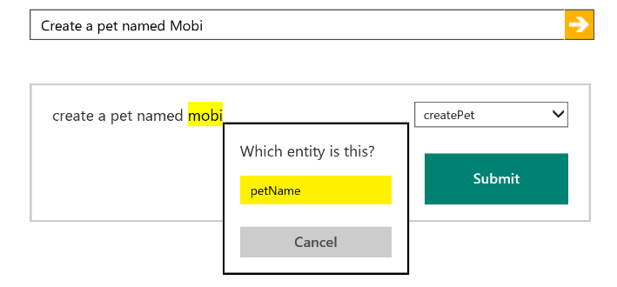
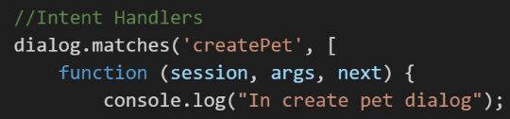
Cognitive Services - LUIS
Identify entities and intents of messages
Train through GUI or programmatically
Built in LUIS intent handling in bot framework

Slide 12
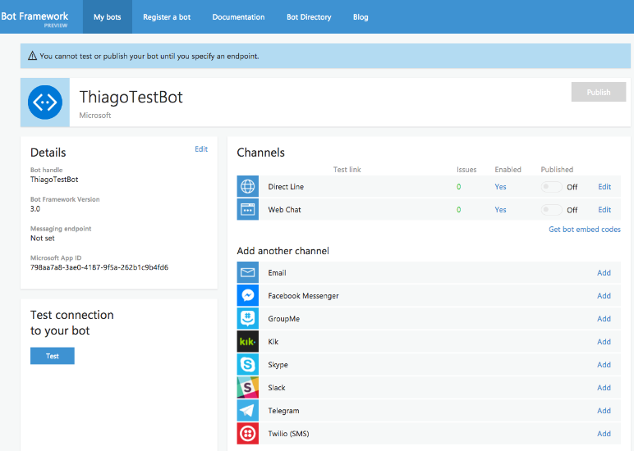
Developer Portal
https://dev.botframework.com/

Slide 13
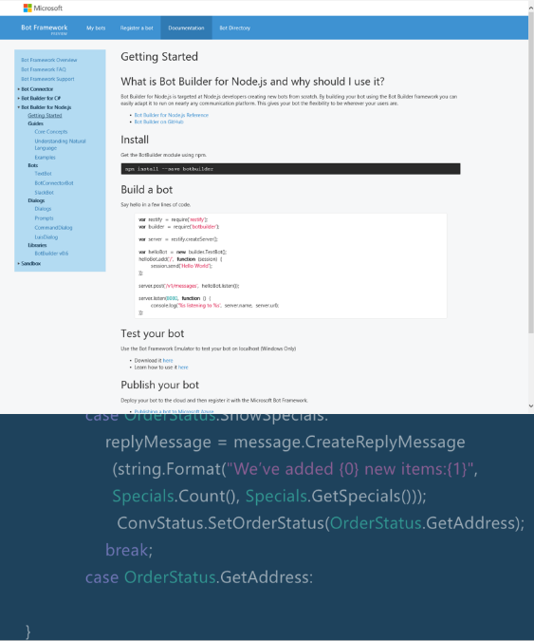
Bot Builder SDKs

Slide 14
Demo
Getting Started
Notes:
Create Project
Create Readme to create Repo
Create Build
Create Release
Create Azure Connection
Create User Story
Create Task
Create Branch
Associate work items
Clone Repo
Add project
Build fails
Show build
Fix build associate bug
Code get deployed
Tour Build and RM
Clone
Show Build from VS
Pin summaries to dashboard
West US
E2EDemo
MyE2EHelloWorldDemo

Slide 15
Getting Started
C#
Visual Studio
http://aka.ms/bf-bc-vstemplate
Node.js
Visual Studio Code
Botbuilder yeoman generator
https://docs.microsoft.com/en-us/bot-framework/bot-builder-overview-getstarted

Slide 16

“DevOps is the union of people, process, and products to enable continuous delivery of value to our end users.”
Donovan Brown
http://bit.ly/WhatIs-DevOps

Slide 17
Why DevOps for Bots?

Slide 18
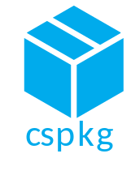
Continuous Integration
Build
It’s just a simple ASP.NET or Node.js web api!
Considerations:
CI for dependent services that you own that are called by the bot
    LUIS, Databases, external APIs
Put bot configs in Environment Variables or Release definition to share the same build

Slide 19
Demo
CI
Notes:
Create Project
Create Readme to create Repo
Create Build
Create Release
Create Azure Connection
Create User Story
Create Task
Create Branch
Associate work items
Clone Repo
Add project
Build fails
Show build
Fix build associate bug
Code get deployed
Tour Build and RM
Clone
Show Build from VS
Pin summaries to dashboard
West US
E2EDemo
MyE2EHelloWorldDemo

Slide 20

Testing
Test
How do you test a bot?
Considerations:
Auth
Mocking connector, mocking LUIS calls
Unit/Functional/Load testing
https://www.microsoft.com/developerblog/real-life-code/2017/01/20/Bot-Framework-Unit-Testing.html
https://github.com/Microsoft/BotBuilder/blob/master/CSharp/Tests/Microsoft.Bot.Sample.Tests/AlarmBotTests.cs#L91
https://github.com/Microsoft/BotBuilder/tree/master/CSharp/Tests/Microsoft.Bot.Builder.Tests/Scripts

Slide 21
Demo
Testing
Notes:
Create Project
Create Readme to create Repo
Create Build
Create Release
Create Azure Connection
Create User Story
Create Task
Create Branch
Associate work items
Clone Repo
Add project
Build fails
Show build
Fix build associate bug
Code get deployed
Tour Build and RM
Clone
Show Build from VS
Pin summaries to dashboard
West US
E2EDemo
MyE2EHelloWorldDemo

Slide 22
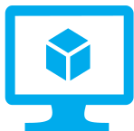
Continuous Deployment
Deploy
It’s just an ASP.NET or Node.js web api!
Considerations:
CD for dependent services that you own that are called by the bot
Updates and retraining of LUIS models and other intelligent systems
Bot state
Functional/performance tests
X

Slide 23
LUIS – Retraining via the API
Importing and exporting the entire LUIS application/model
https://westus.api.cognitive.microsoft.com/luis/v1.0/prog/apps/{appId}/export
https://westus.api.cognitive.microsoft.com/luis/v1.0/prog/apps/import?appName={appName}
Bulk importing ‘labels’ then retrain the model
https://westus.api.cognitive.microsoft.com/luis/v1.0/prog/apps/{appId}/examples
https://westus.api.cognitive.microsoft.com/luis/v1.0/prog/apps/{appId}/train

Slide 24
Demo
CD
Notes:
Create Project
Create Readme to create Repo
Create Build
Create Release
Create Azure Connection
Create User Story
Create Task
Create Branch
Associate work items
Clone Repo
Add project
Build fails
Show build
Fix build associate bug
Code get deployed
Tour Build and RM
Clone
Show Build from VS
Pin summaries to dashboard
West US
E2EDemo
MyE2EHelloWorldDemo

Slide 25
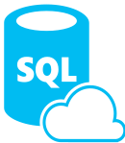
Telemetry – Learn from users
Telemetry
App Insights!
Considerations:
PII, privacy and consent
Identifying paths in the conversation, learn and improve – conversational A/B Testing
Analyze whole conversation, not just last message
Reporting / querying / dashboards
https://github.com/Microsoft/BotBuilder-Samples/tree/master/CSharp/core-AppInsights
https://github.com/CatalystCode/bot-fmk-dashboard
https://blogs.msdn.microsoft.com/jamiedalton/2016/07/11/ms-bot-framework-formflow-build-and-deploy-a-bot-with-ease/
X
X

Slide 26
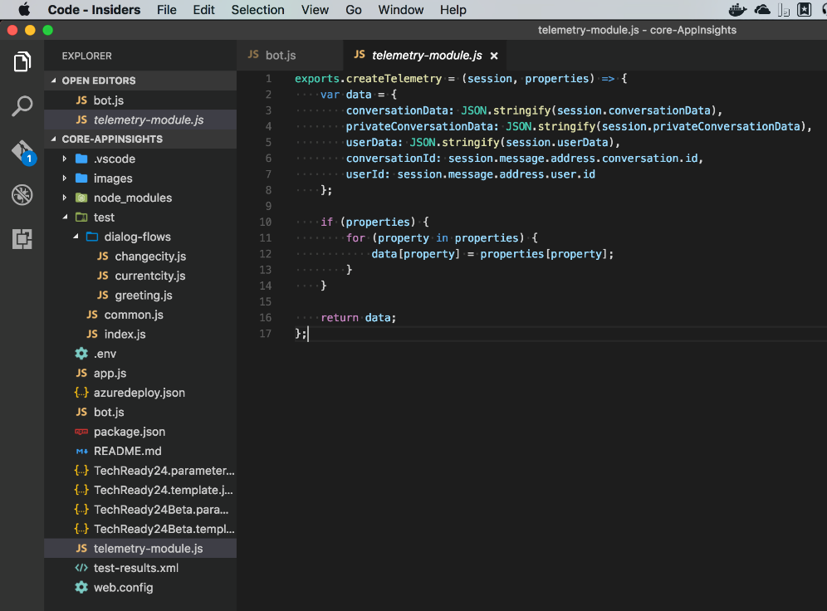

Slide 27
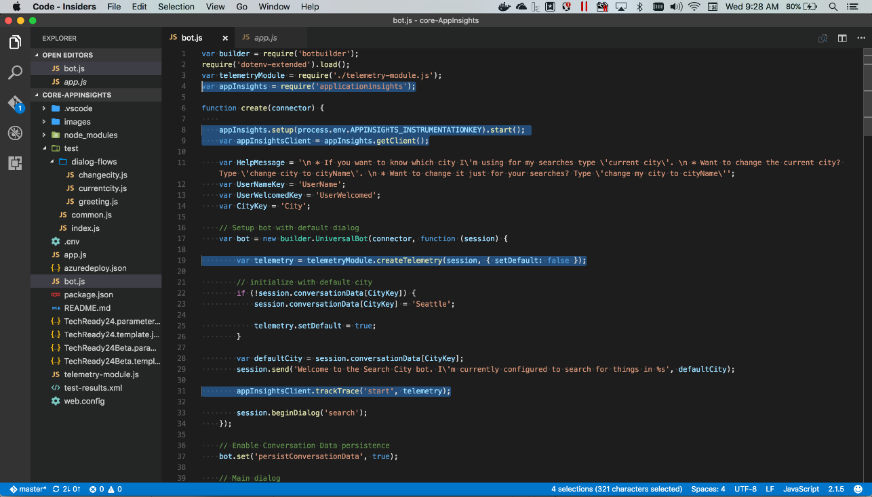

Slide 28
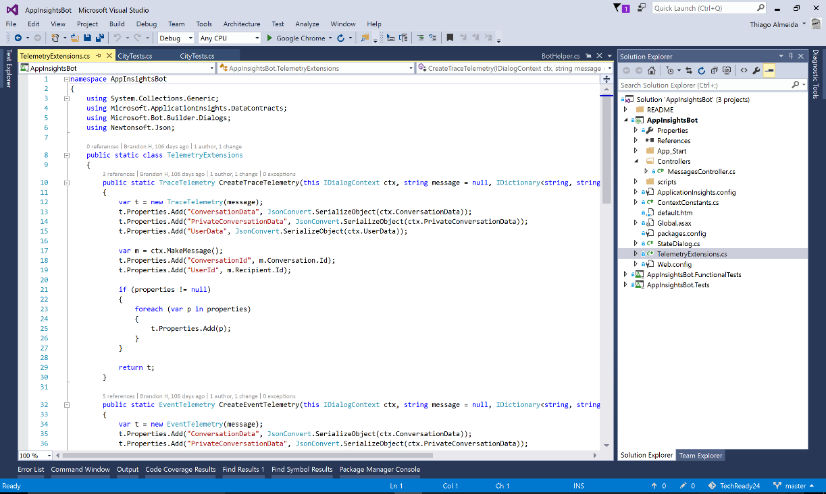

Slide 29
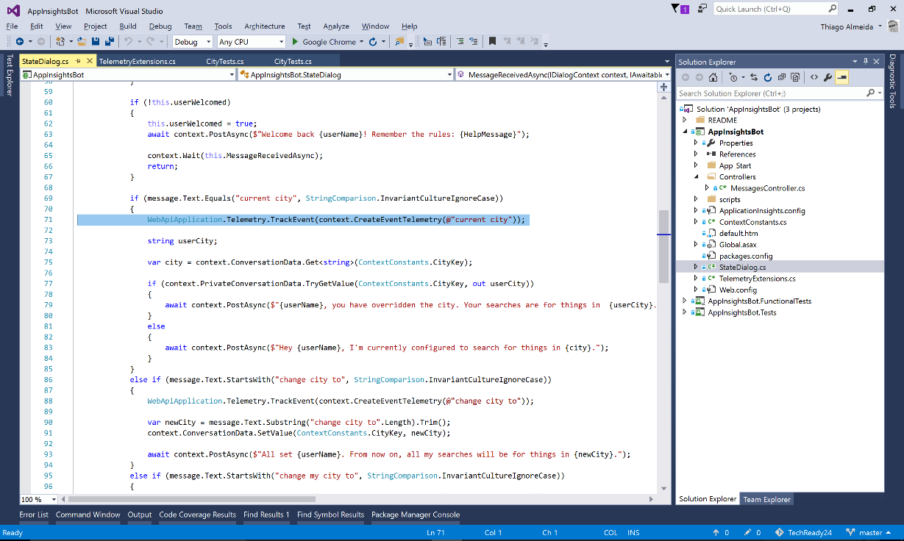

Slide 30
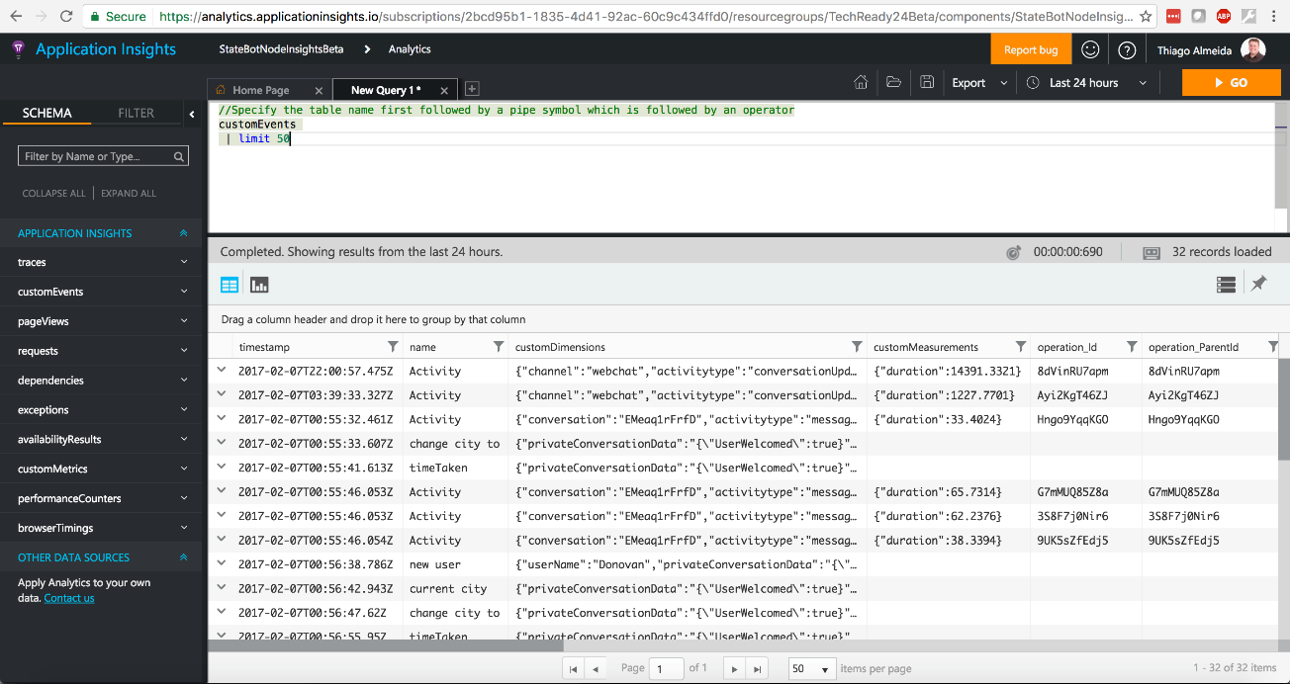

Slide 31
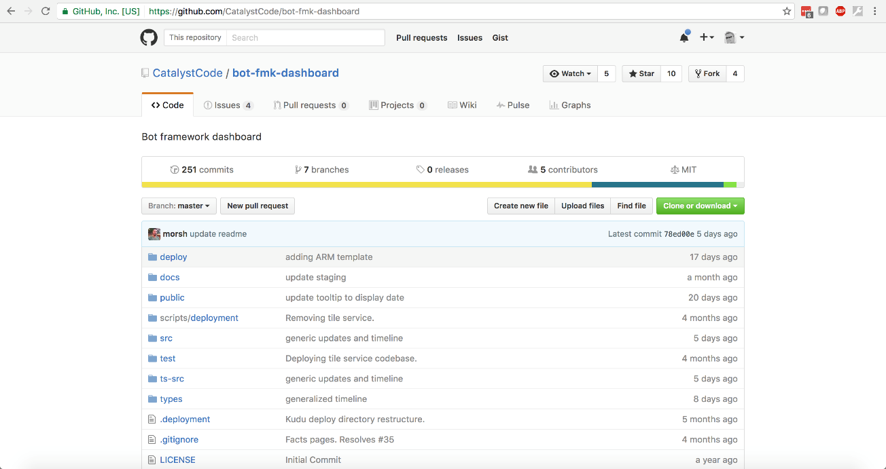

Slide 32
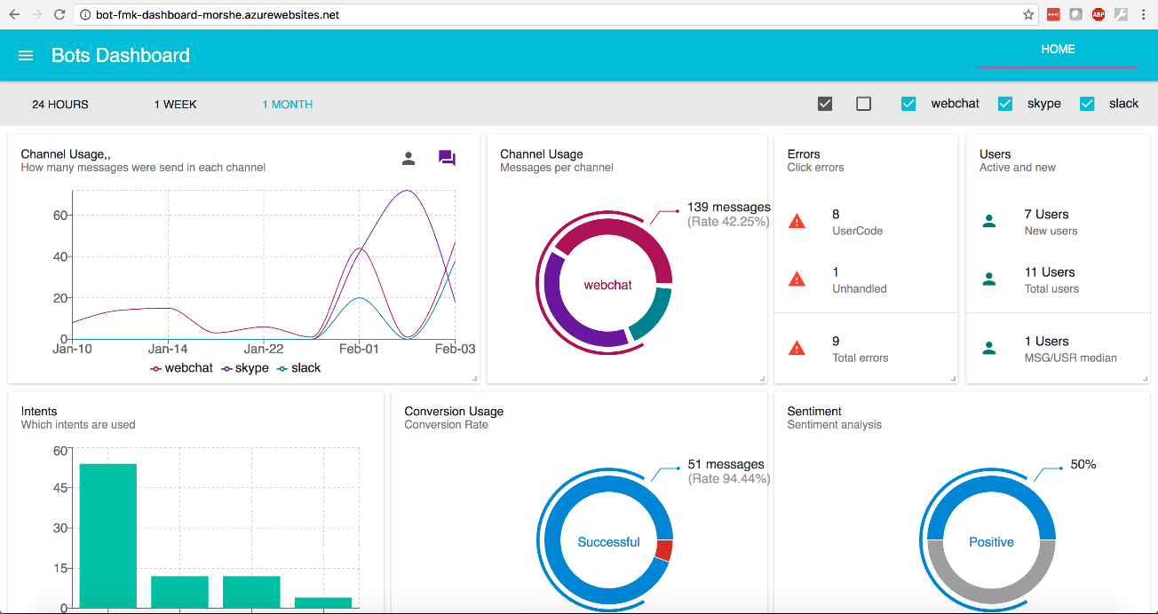

Slide 33
Where to find docs/samples
Bot framework:
www.botframework.com
https://aka.ms/botcourse
https://github.com/nzthiago/BotInsightsTests
Code samples:
https://github.com/Microsoft/BotBuilder-Samples
https://github.com/Microsoft/BotBuilder
DevOps:
https://channel9.msdn.com/Series/DevOps-Fundamentals
https://microsoft.github.io/PartsUnlimitedMRP/ https://microsoft.github.io/PartsUnlimited/

Slide 34
In review: session objectives and takeaways
Session objectives:
  Introduce the concepts of DevOps, with considerations for bots
  Demonstrate how to implement these DevOps practices for bots that use the Microsoft Bot Framework
Session takeaways:
  DevOps culture and practices can be applied everywhere
  Microsoft Bot Framework makes it easy to build, automate, test, and deploy bots

Slide 35
Q&A

